Slide 1
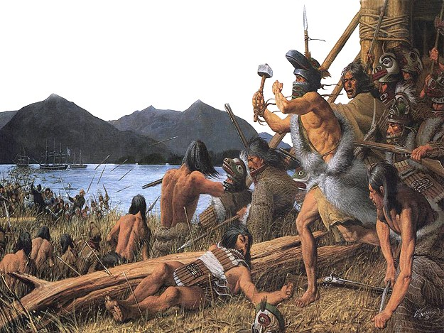

Exploring Conflict and Colonization
The Sitka Battles of 1802 and 1804
Notes:
Hello everyone! My name is ­­­________ and I am a(n) __________ here at Sitka National Historical Park in Sitka, Alaska. Your teacher M(r/s.) ________ has invited me here today to talk to all of you about a very important event in this history of this place that we call Alaska- The Battles of 1802 and 1804 that took place right here in Sitka, and even right here in our national park.

Slide 2
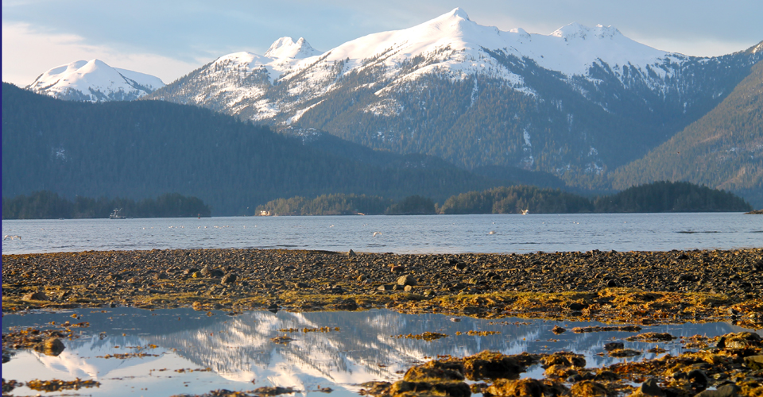
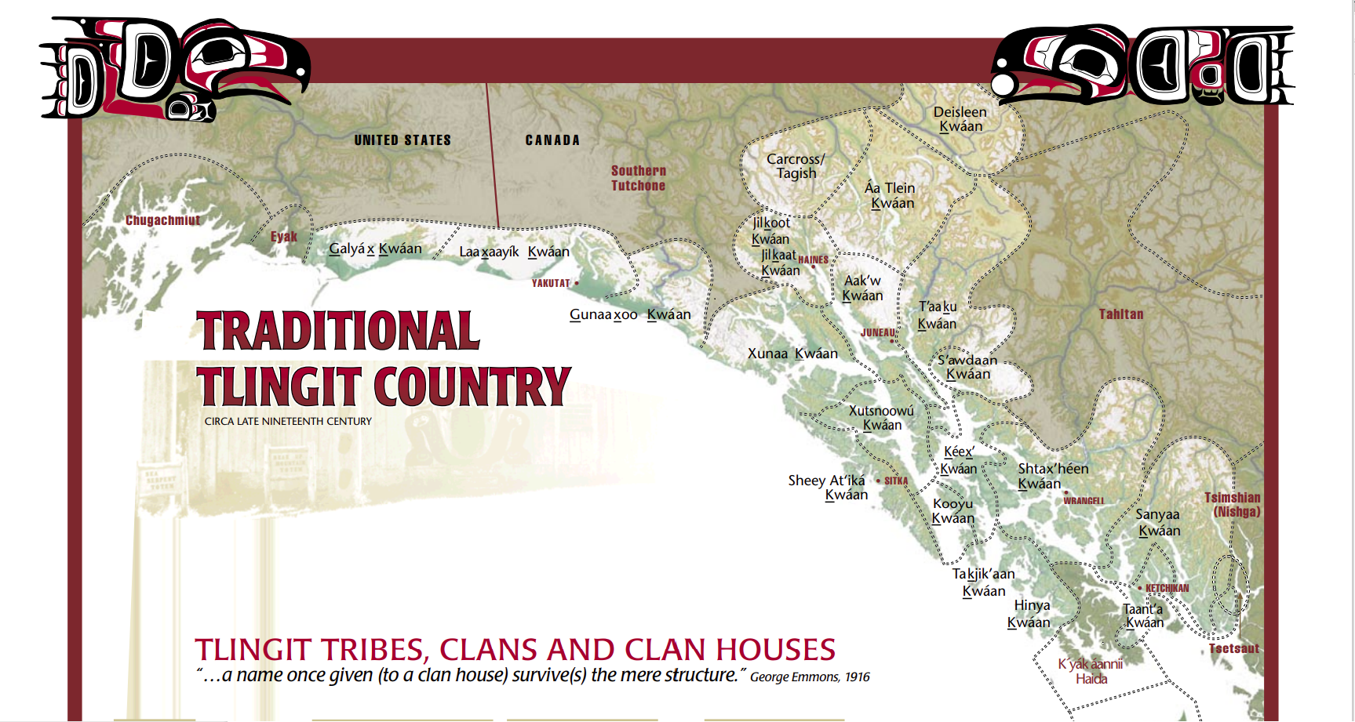
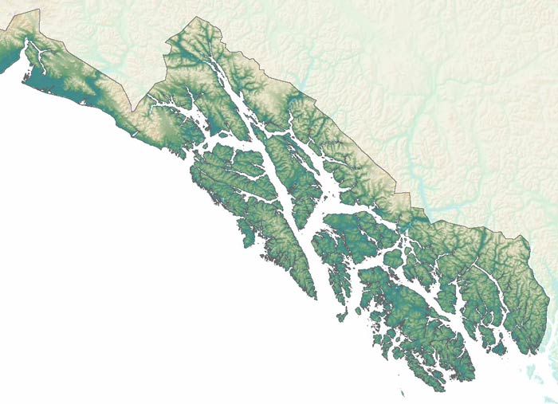
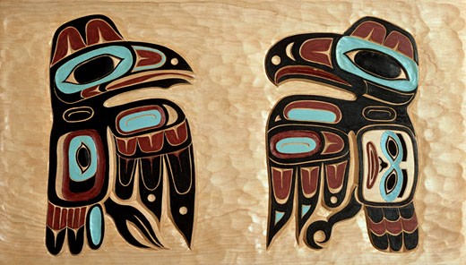
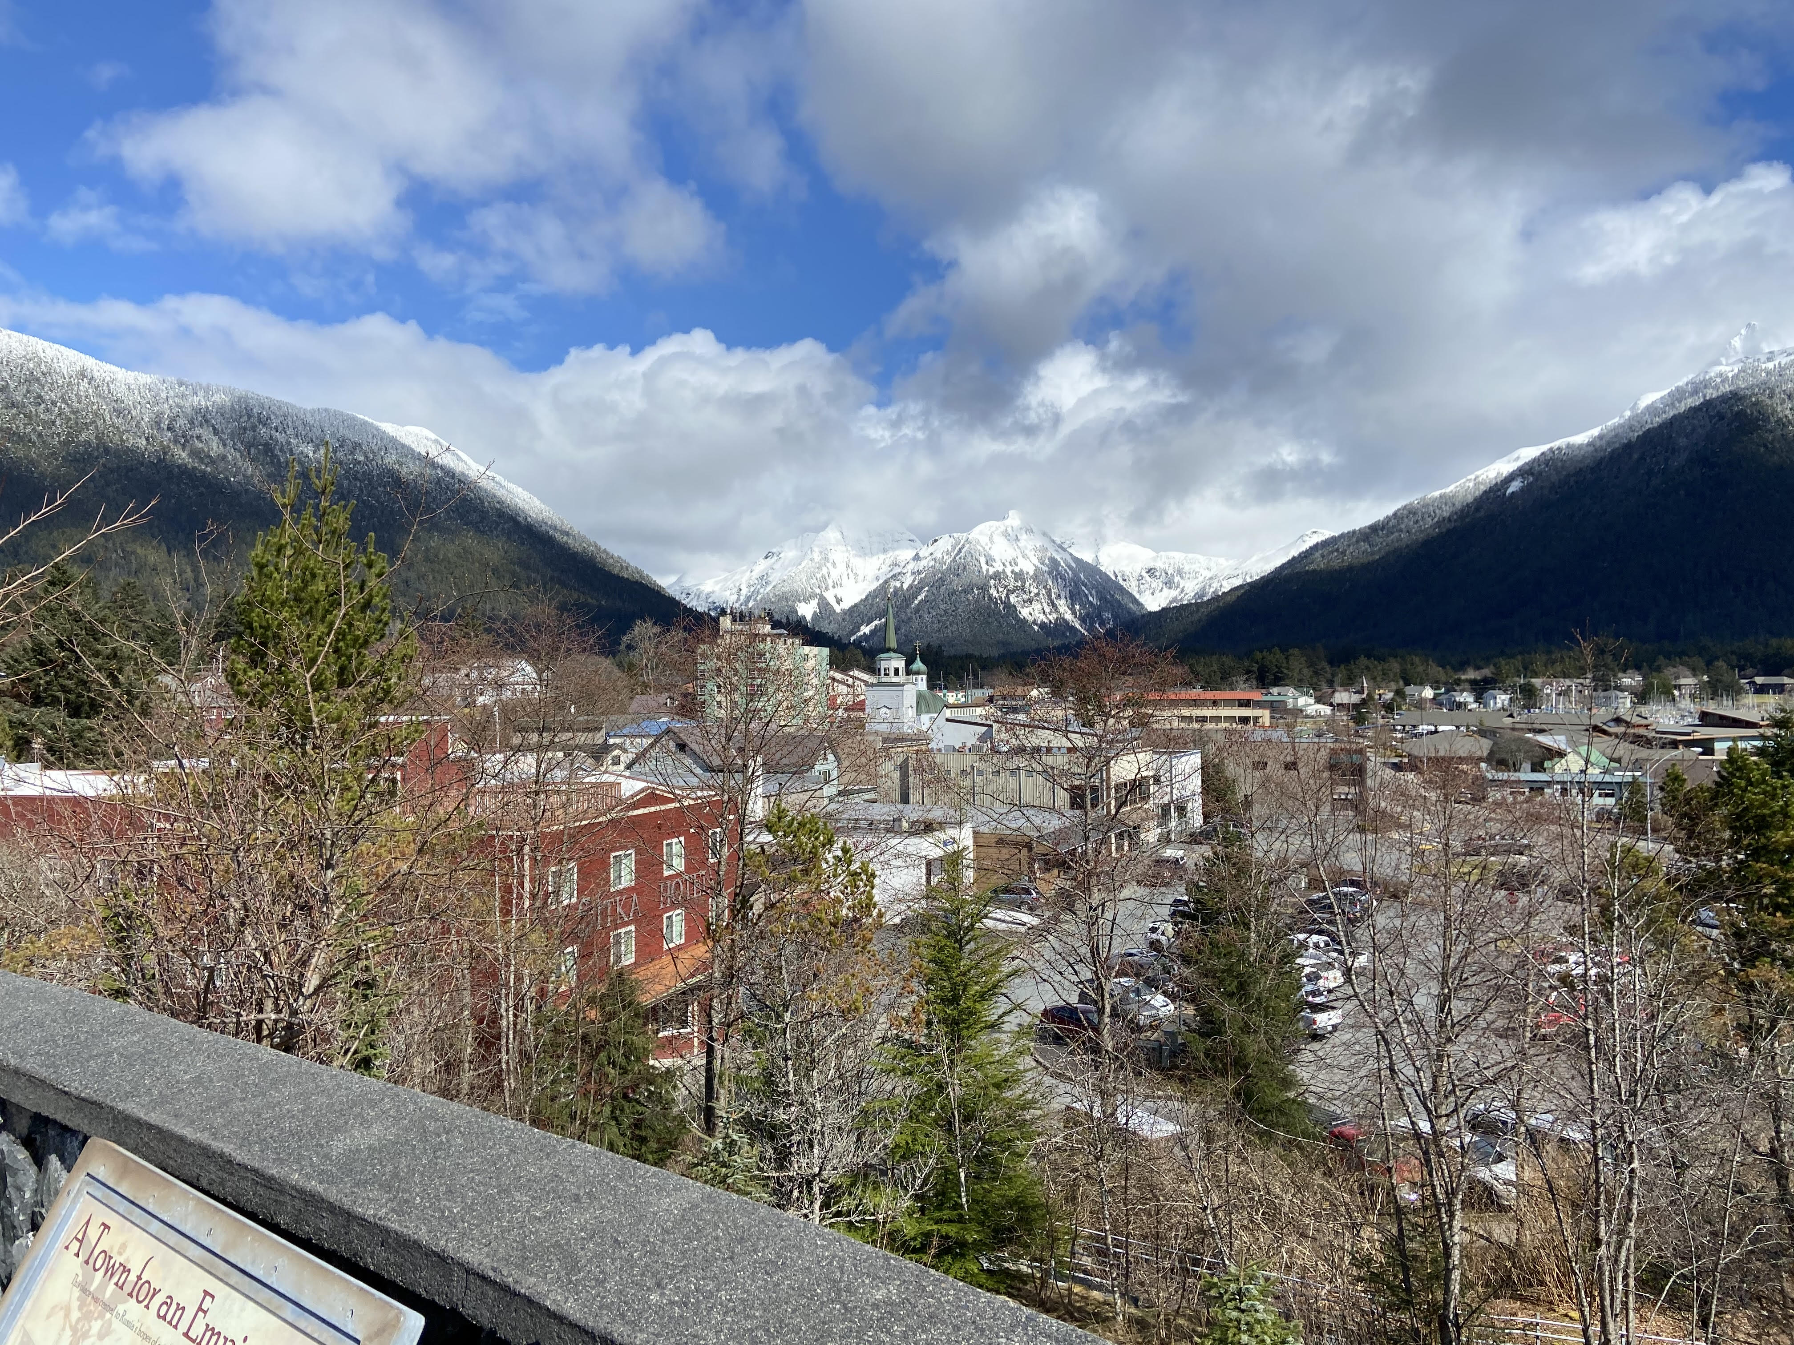
The city of Sitka is located in Southeast Alaska, on an island that today we call Baranof Island
This land is the traditional homeland of the Tlingit people
Southeast Alaska and the City of Sitka
This place has been traditionally occupied by two different Tlingit clans, the Kiks.ádi and the Kaagwaantaan
  These clans belong to different moieties, or family groups. The Kiks.ádi belong to the Raven Moiety, and the Kaagwaantaan belong to the Eagle Moiety
Southeast Alaska, and the indigenous people who have called this place home for thousands of years, are unique
Notes:
Now before we get to talking about history, we’re going to take a step back and talk about the City of Sitka and Southeast Alaska. On the top here, you can see a rocky beach leading to a waterway before climbing up a large, tree covered mountain- this photo was actually taken right here in Sitka National Historical Park. On the bottom, you can see the City of Sitka nestled in between some mountains, with three mountains that we call the “Three Sisters” framing the back- if you look closely, you’ll be able to see the green spire of Saint Michael’s Orthodox Church in the center of town. The City of Sitka is located in Southeast Alaska, on a large island that today, we call Baranof Island. This island is part of a much larger chain, which together we call the Alexander Archipelago.
This land that we live on is the traditional homeland of the Tlingit people- a group of Alaskan native people who live throughout the entire Alexander Archipelago and even into Canada. On the top, you can see a map of the land traditionally claimed by the Tlingit people. This map is broken up into different kwaans, which are similar to states. On the bottom, you can see a map of the Alexander Archipelago, with the water colored white and the various islands shaded green. This large island in the center is Baranof Island, where Sitka is today. The Tlingit called this island Shee, and they’ve lived here since ‘time immemorial’- evidence found by archaeologists tell us that they’ve likely lived here for at least 10,000 years.
The Tlingit live in clans- historically, the largest Tlingit clans here on Baranof Island were the Kiks.ádi and the Kaagwaantaan. These two clans come from different moieties, which are large groups of clans- the Kiks.ádi come from the Raven Moiety, and the Kaagwaantaan come from the Eagle Moiety. That there are two groups is an important part of Tlingit culture, which celebrates the duality in all things- for example, in traditional Tlingit culture, people from the same moiety cannot get married- you have to marry someone from the other moiety. In this bottom picture, you can see Raven on the left and Eagle on the right, carved into a large piece of yellow cedar. You can see the unique styling and beautiful coloration of Tlingit art, which today we call “formline art”.
These traditions are unique to Southeast Alaska and the people who have called this place home for thousands of years- In this time, these people have learned to master the land and its resources, taking advantage of the natural bounty that could be found here. They’ve developed unique linguistic, cultural, and social traditions- as well as totally distinct styles of art, architecture, and aesthetics.

Slide 3

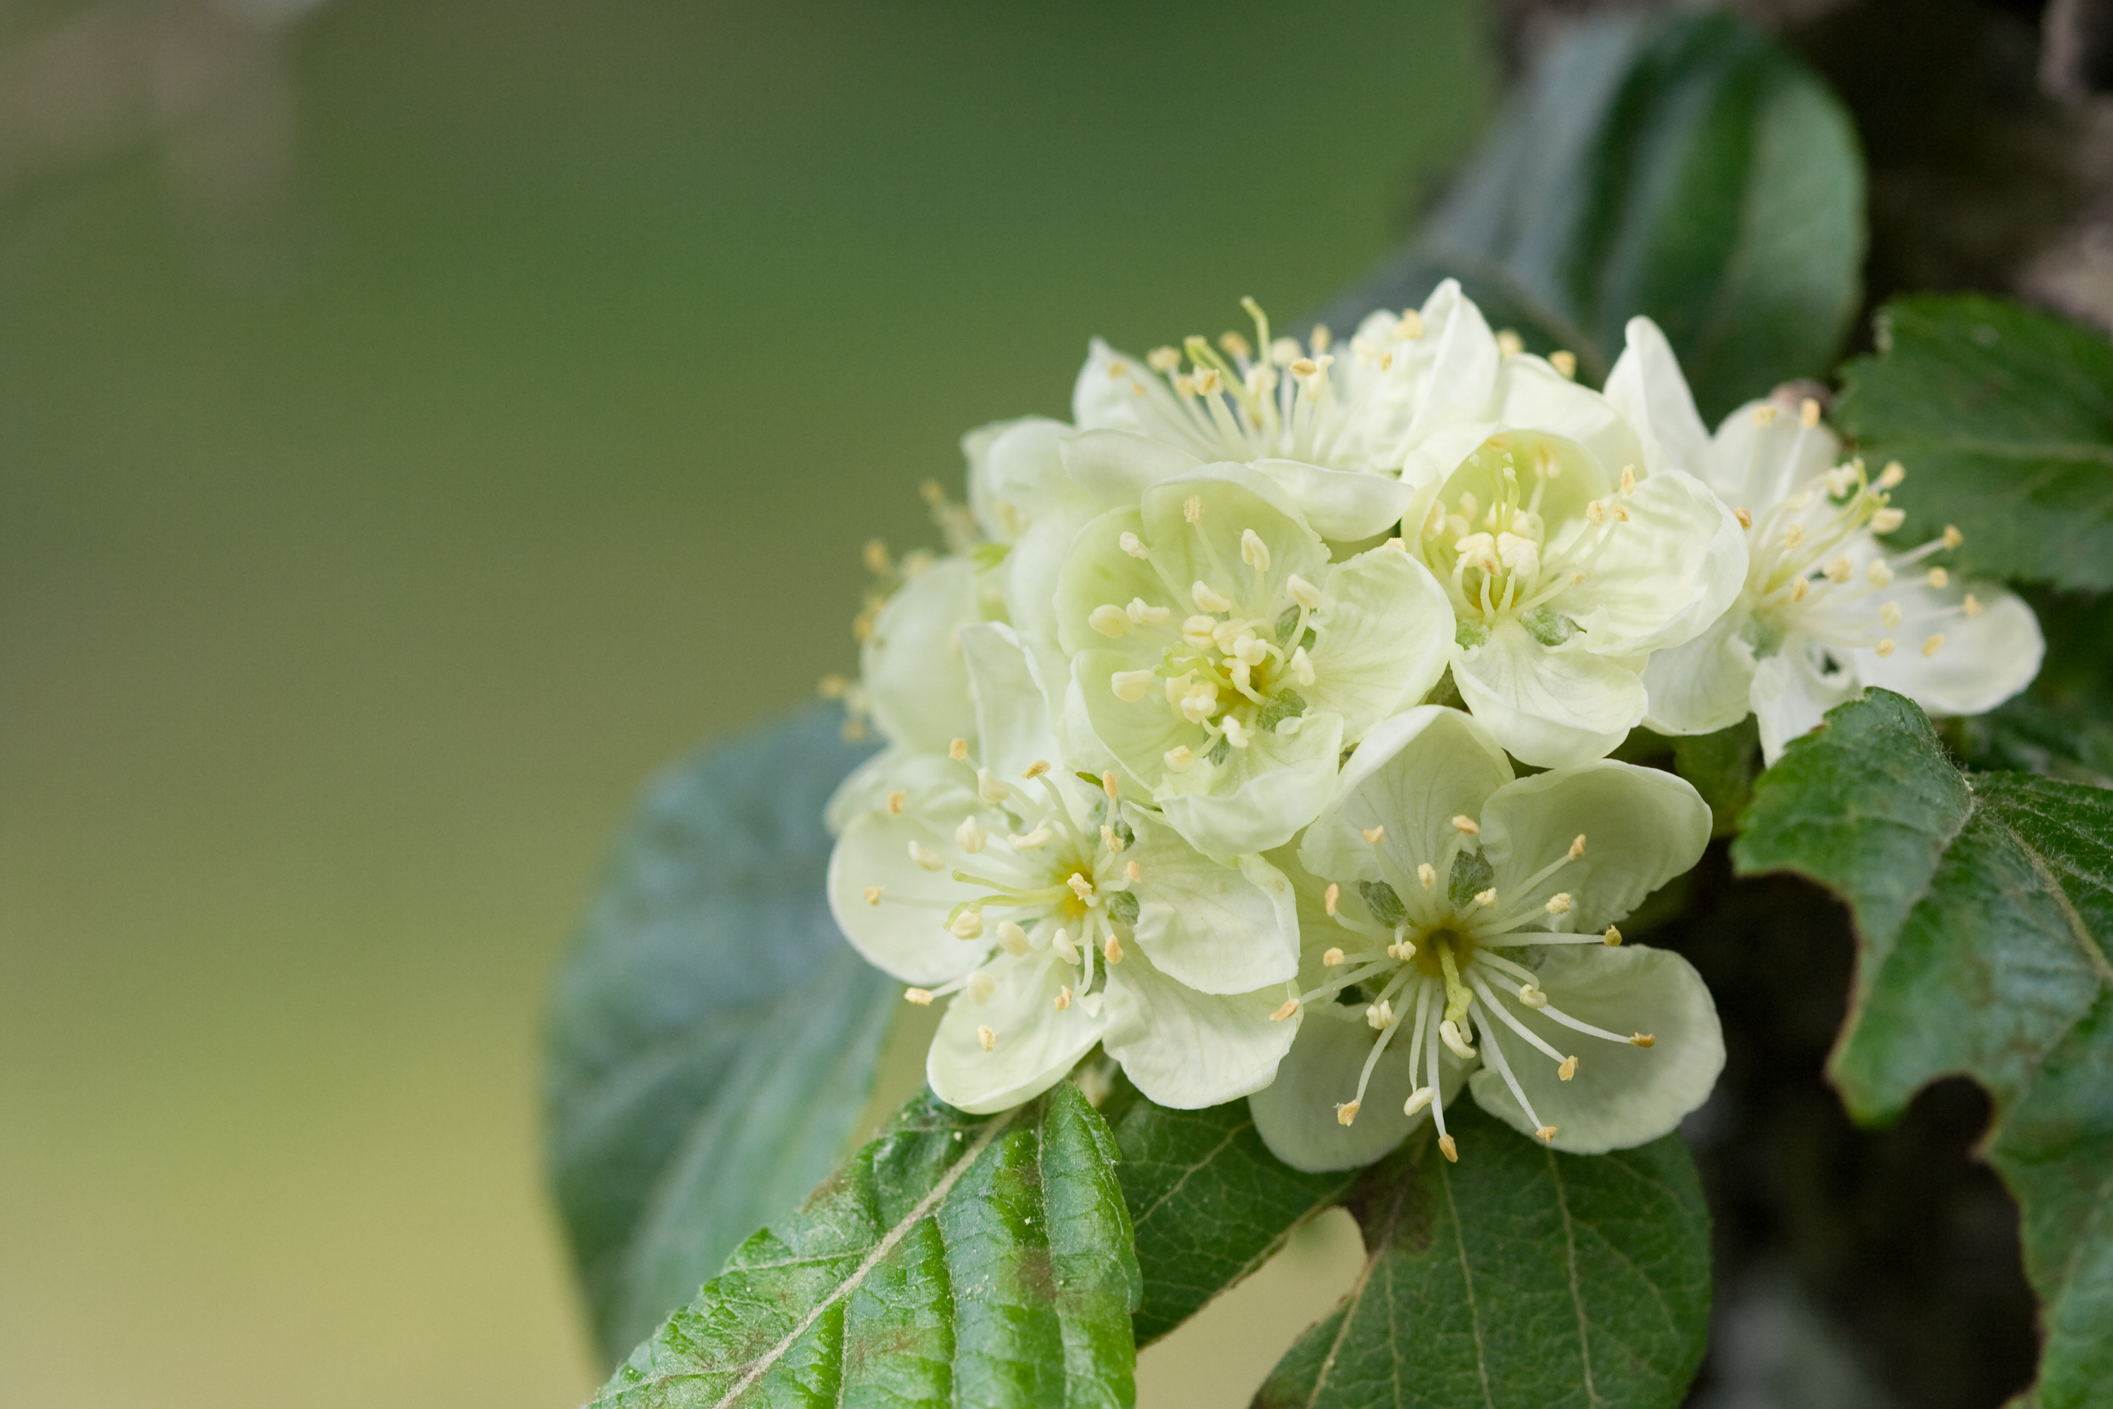
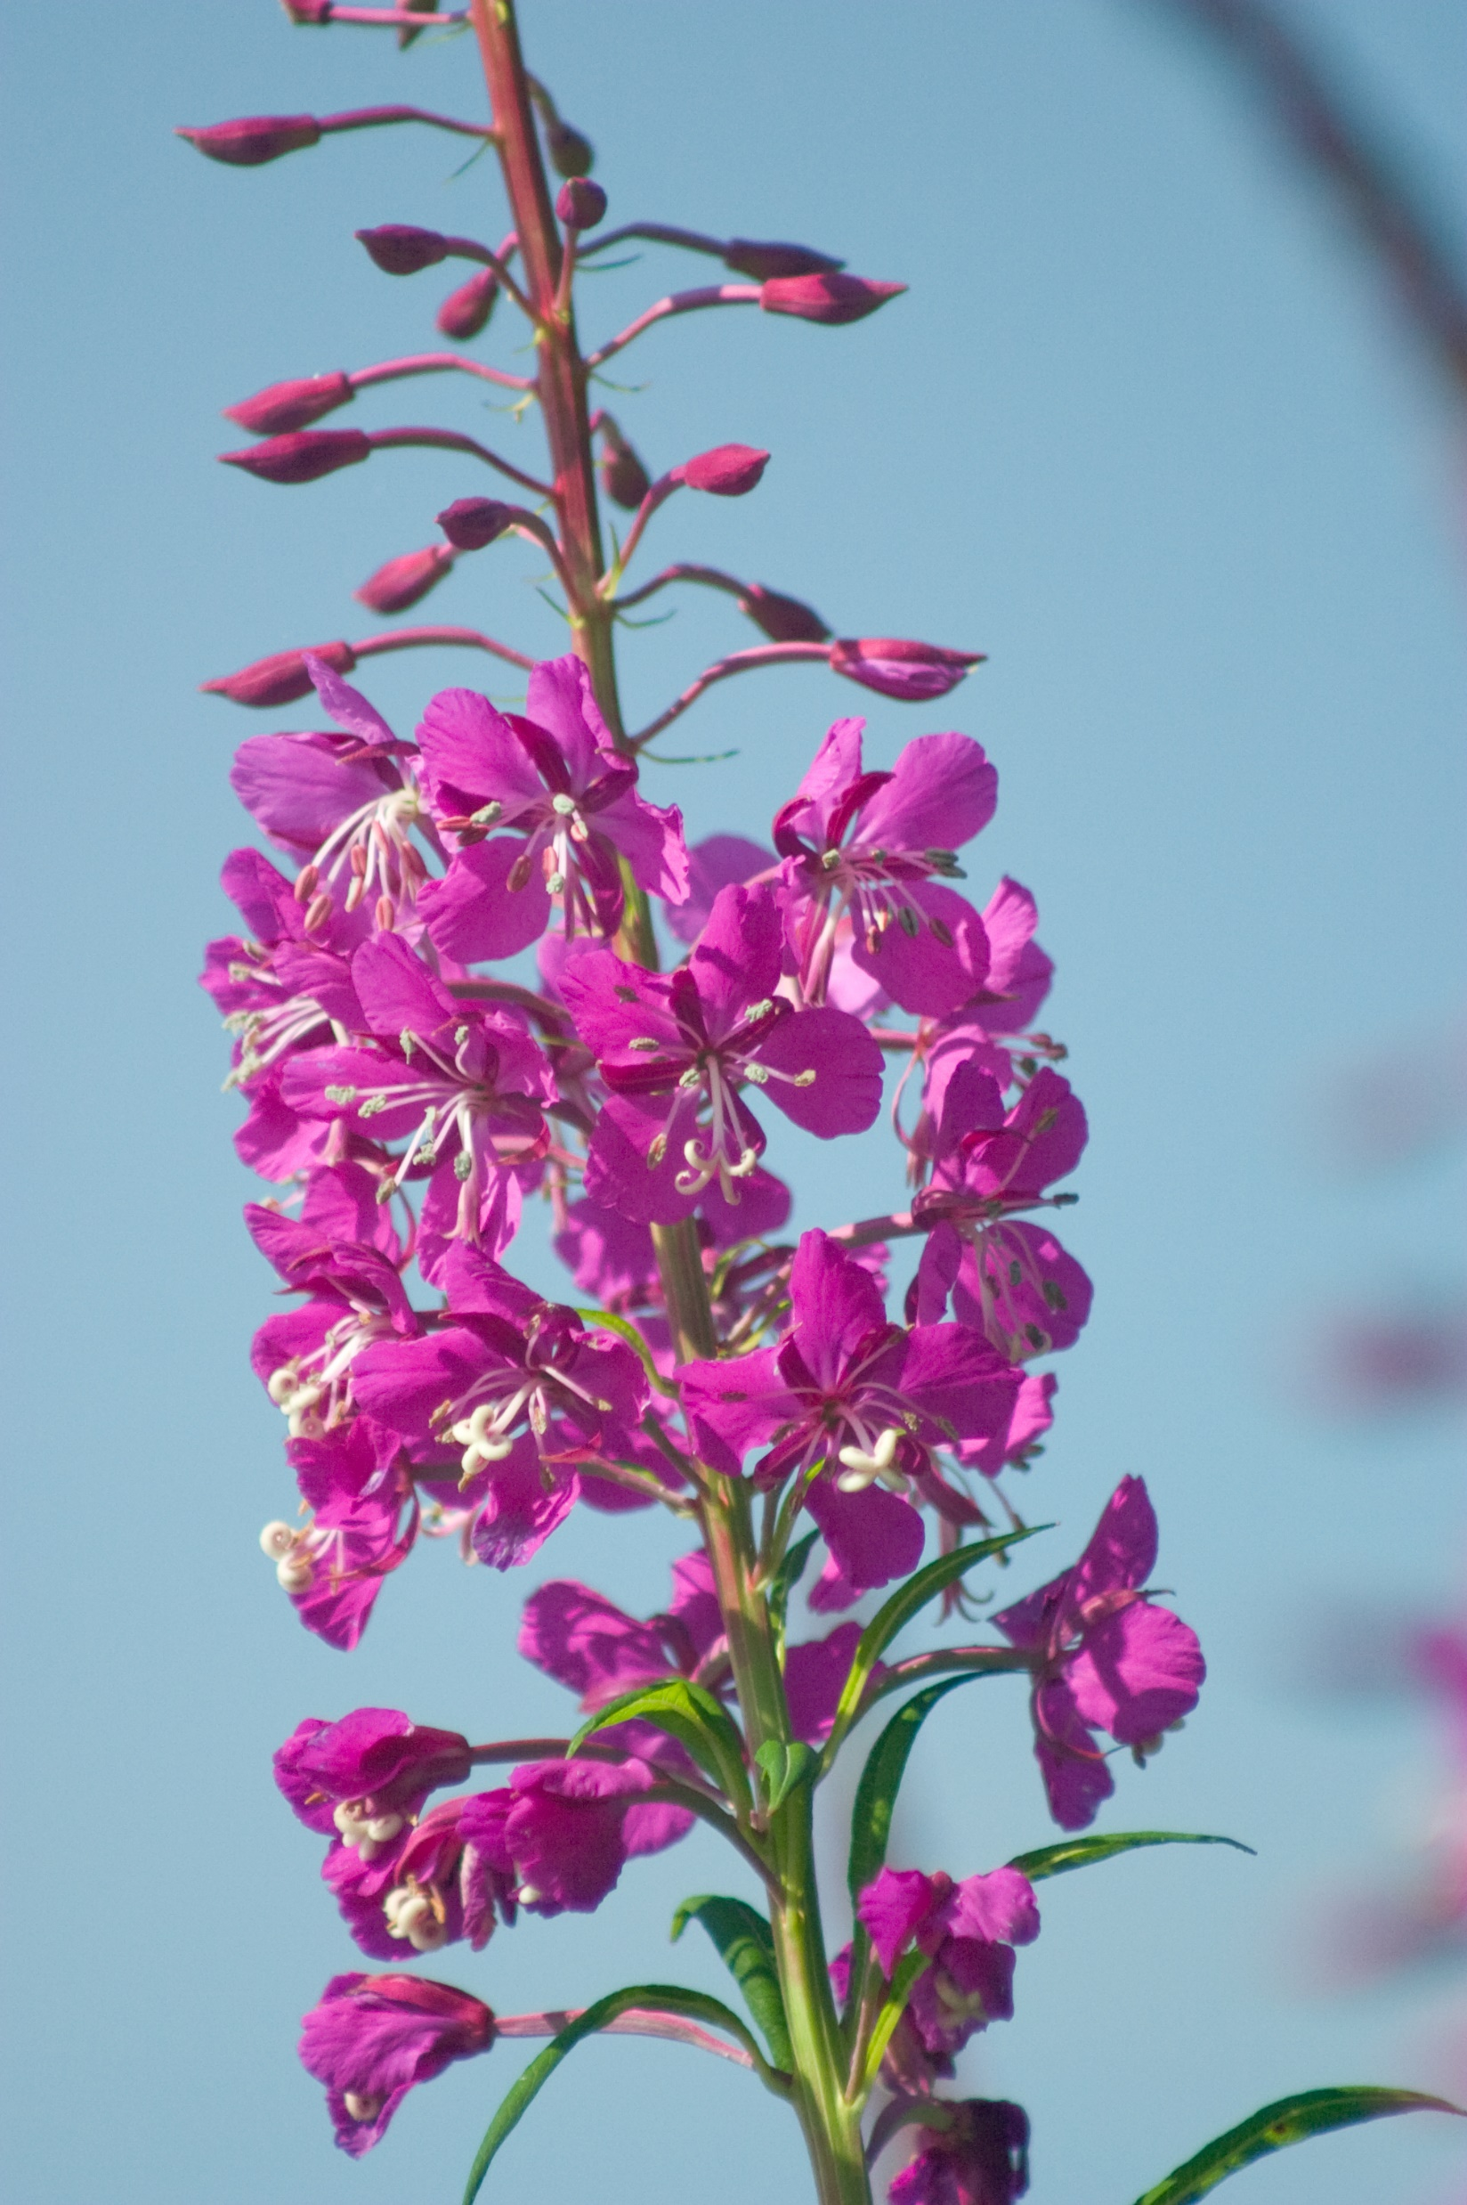
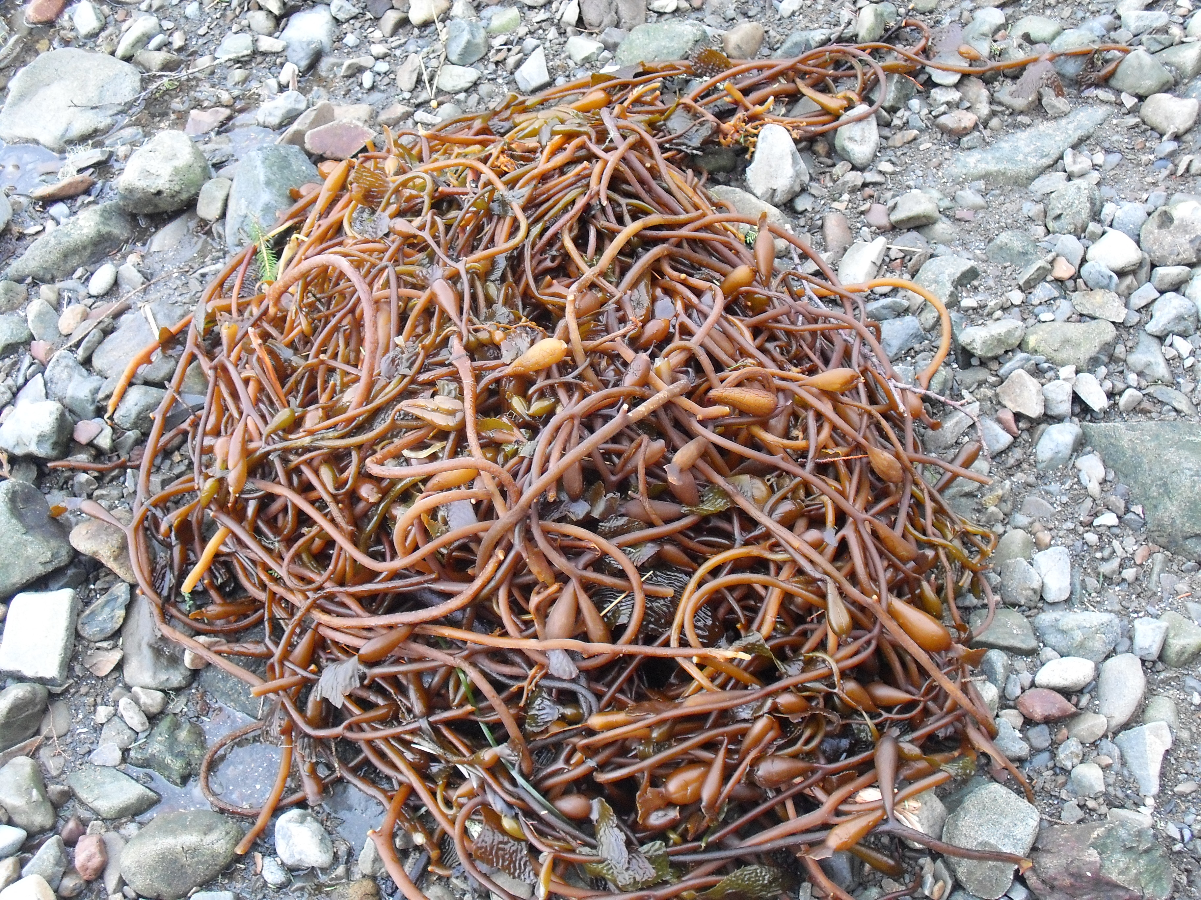
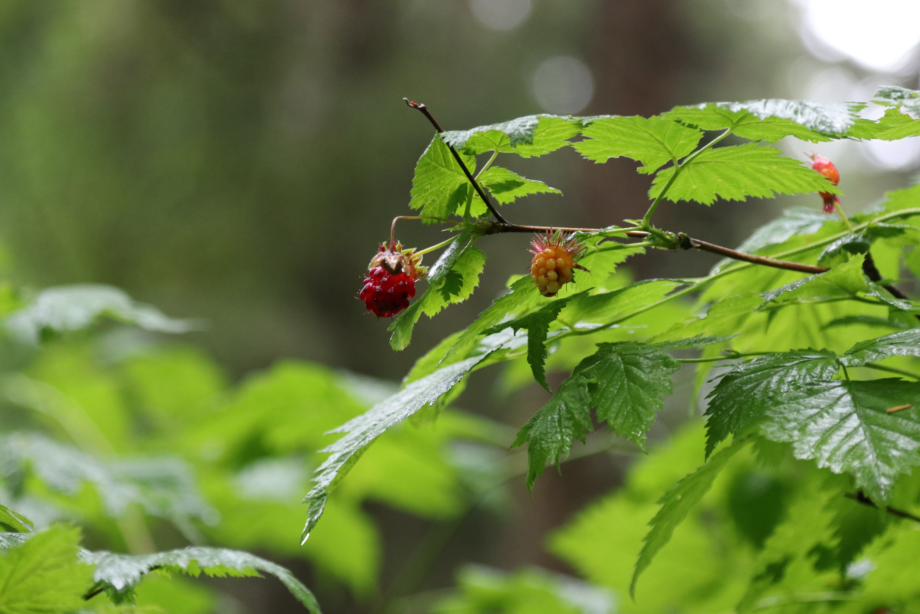
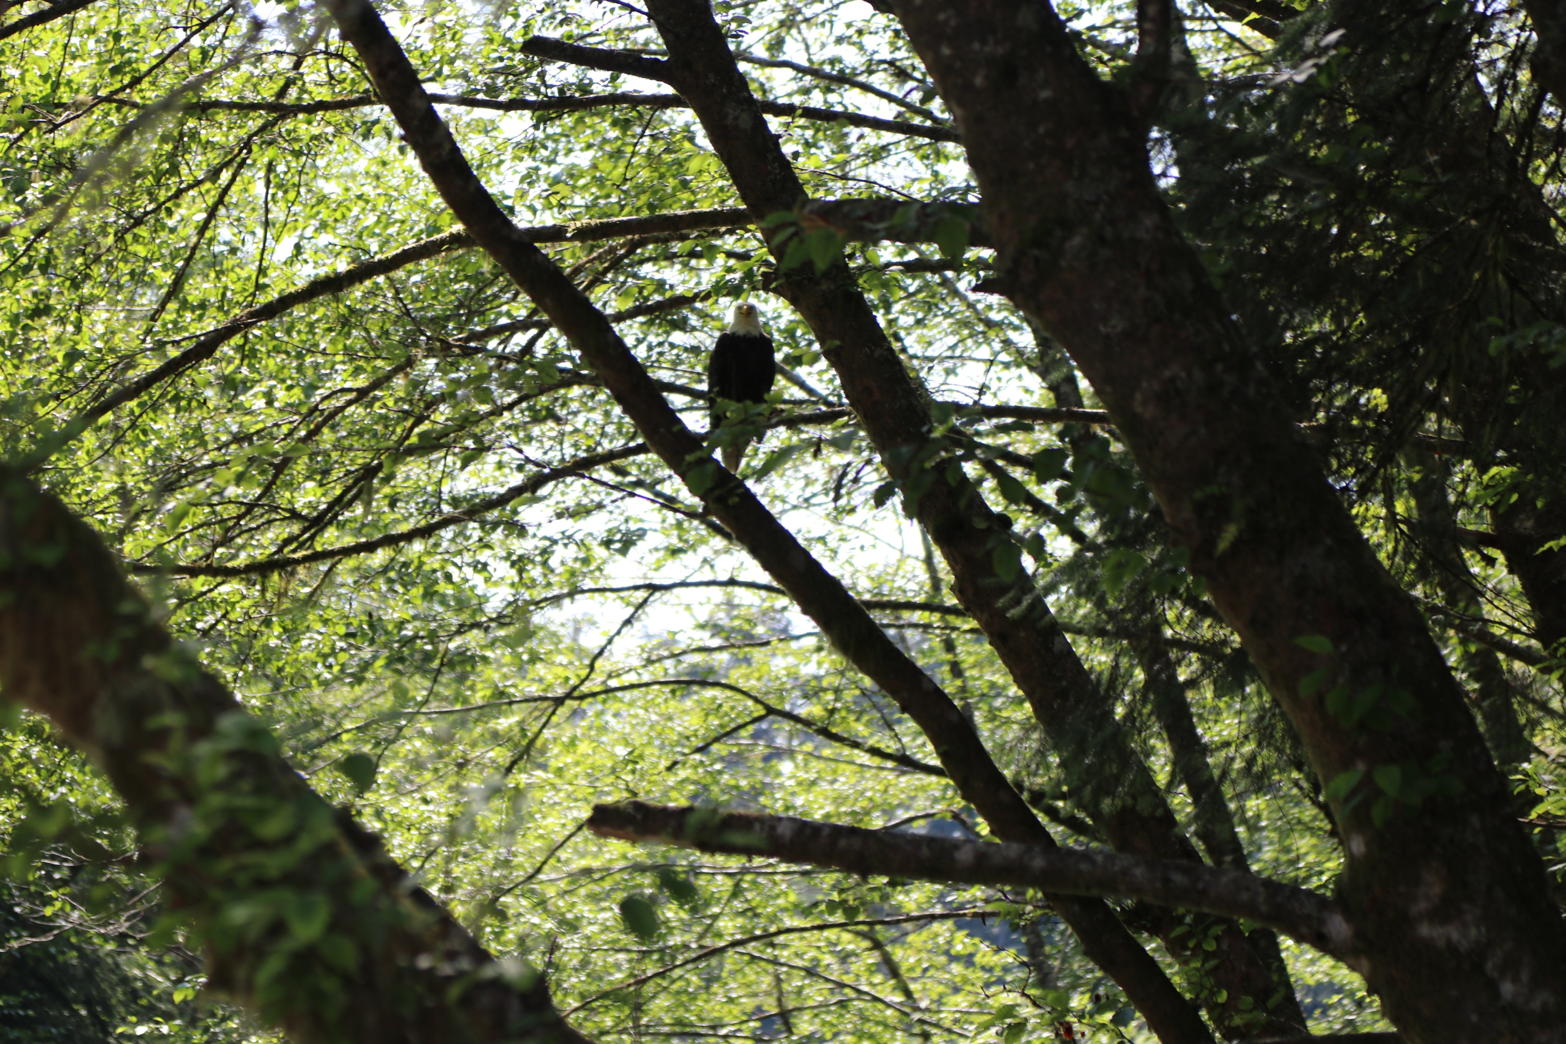
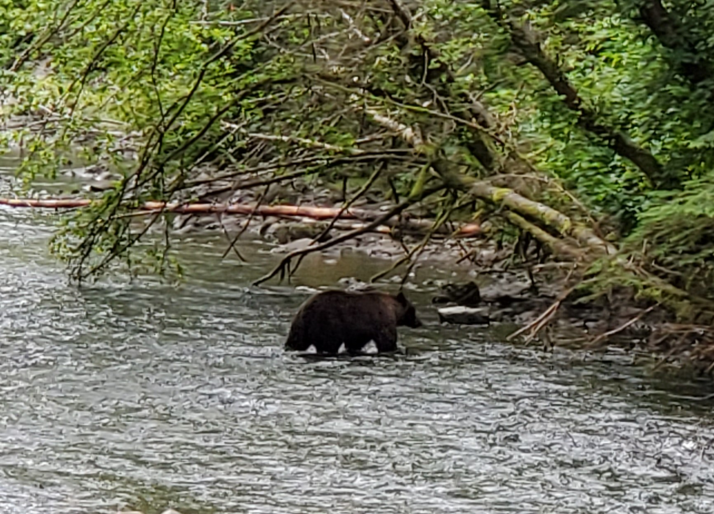
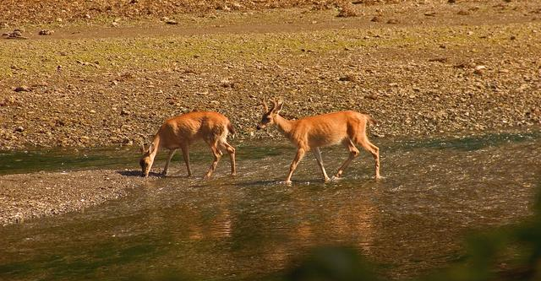
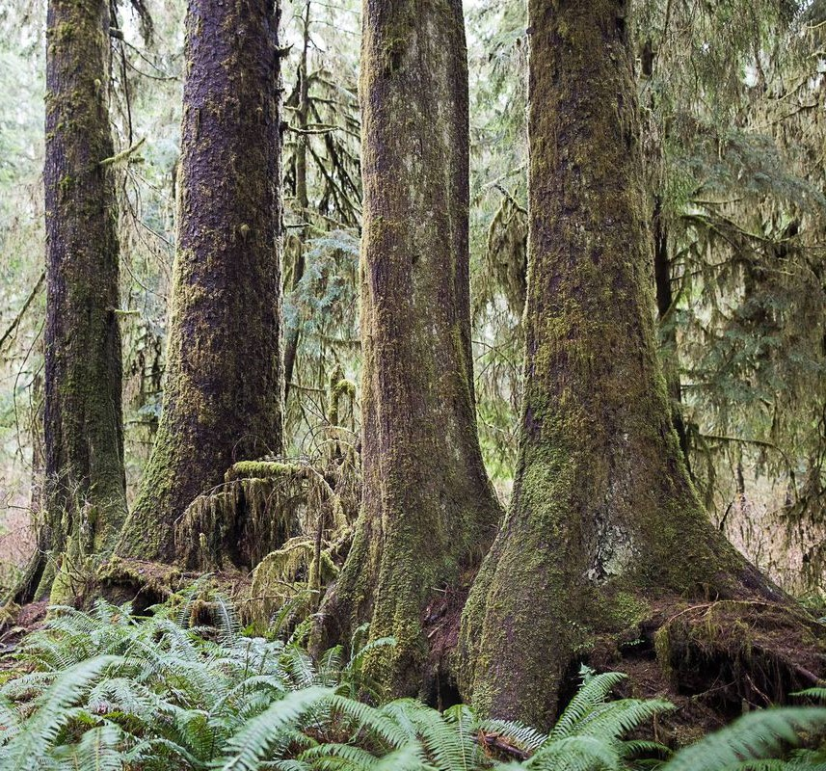
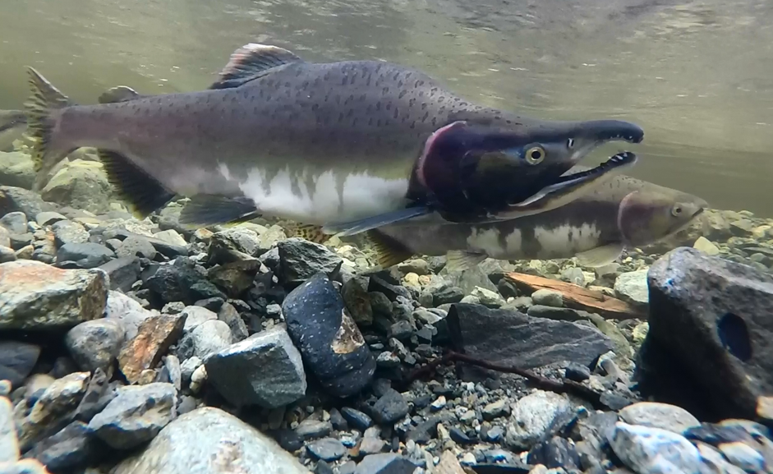
What does “a natural abundance of resources” mean to you? What kind of images does it bring to mind?
Why did Europeans come to Alaska? What resource did they want here?
Notes:
Now, what do you think I mean when I say “a natural abundance of resources”- what kind of images does that bring to your mind? On this slide, you can see pictures of various animals that we regularly see here in Sitka like otters, eagles, bears, deer, and salmon- but a natural abundance of resources can be so much more than just animals. For example, we could be talking about the different types of plants you can find in a place- in these new pictures you can see different types of plants we have here in Sitka like salmonberries, mountain ash, fireweed, kelp, and the giant Sitka Spruce trees. For me, it makes me think of ___________ (insert a personal story about a time you’ve witnessed or experienced a natural bounty here; for example, I might talk about hiking in Maine and finding a mountaintop covered in wild blueberries and spending time eating handful after handful of them). Has anyone else had an experience like that?
Have students give examples
Yeah, that’s a great example! Here in Southeast Alaska, and especially here on Baranof Island, the abundance of natural resources really allowed a variety of cultures, like the Tlingit, to thrive in very unique ways.
The natural resources that can be found here also attracted the attention from Europeans as well; particularly one resource in general- does anyone know which one?
Have students guess

Slide 4
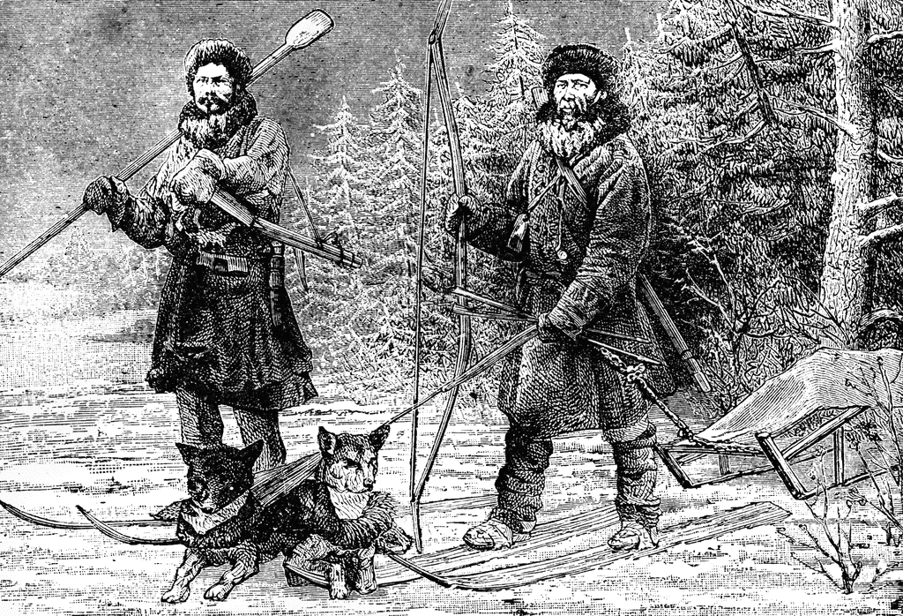
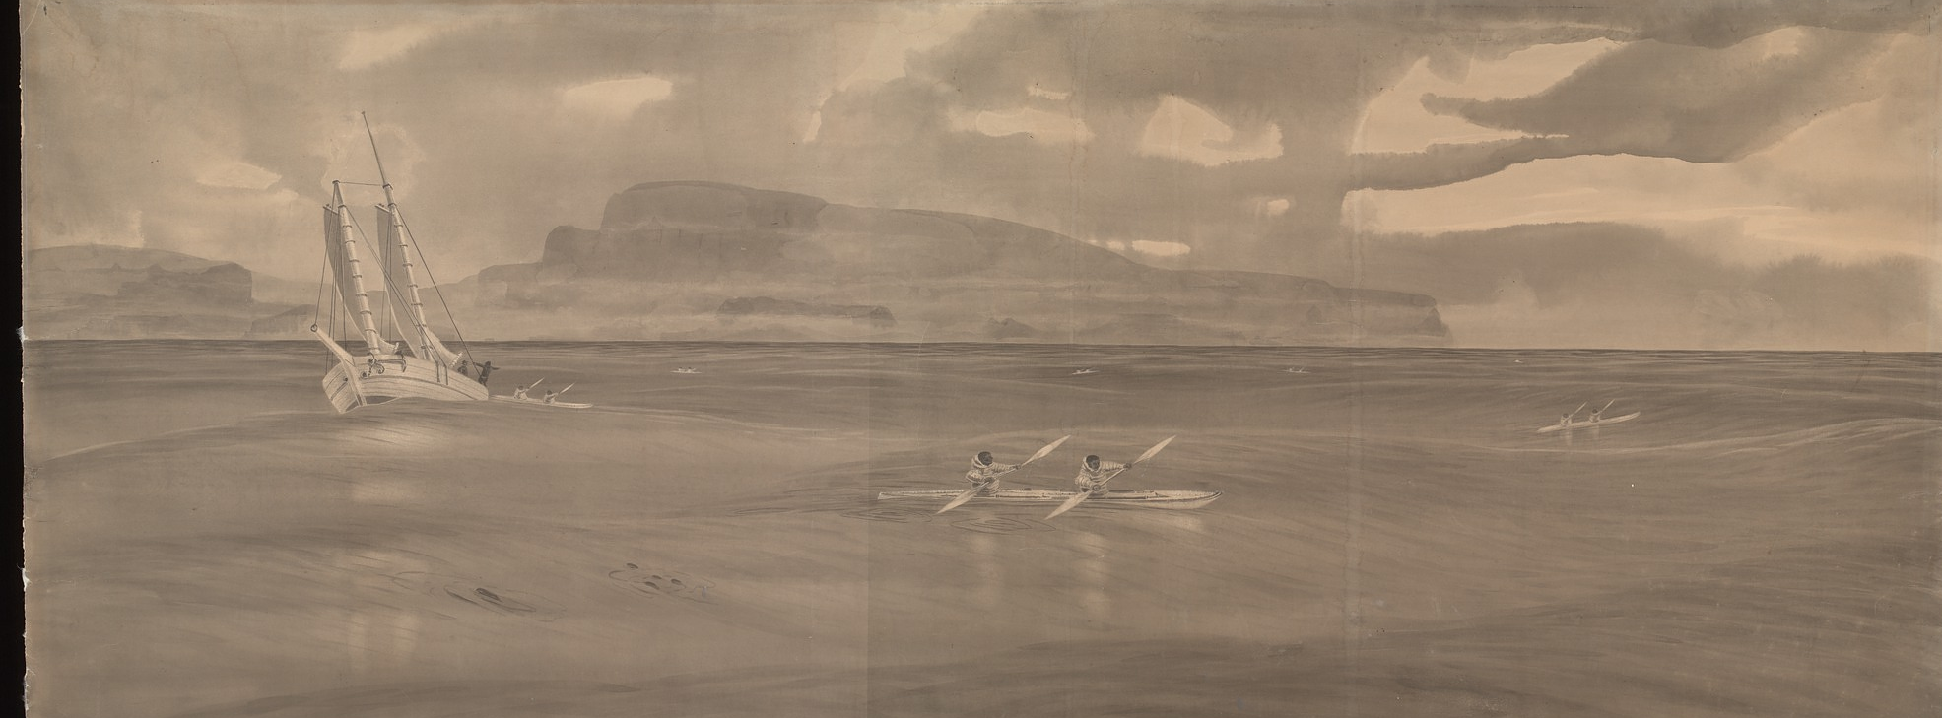
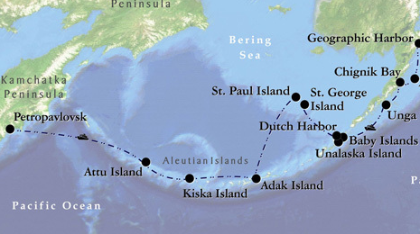
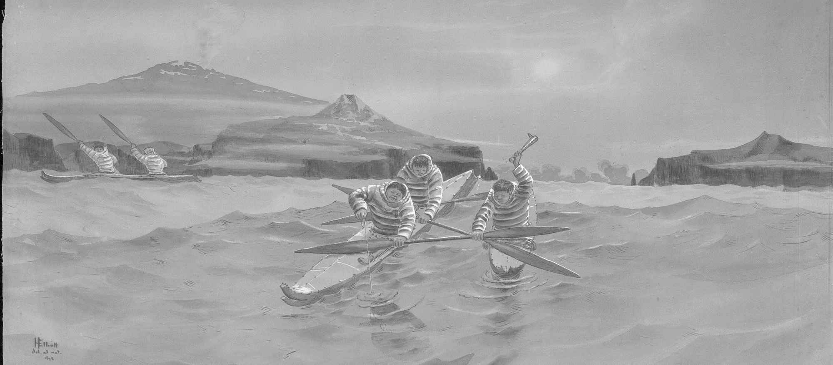
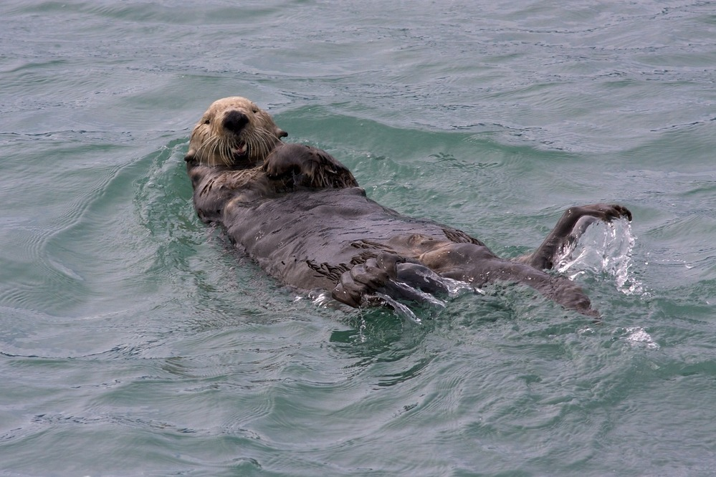
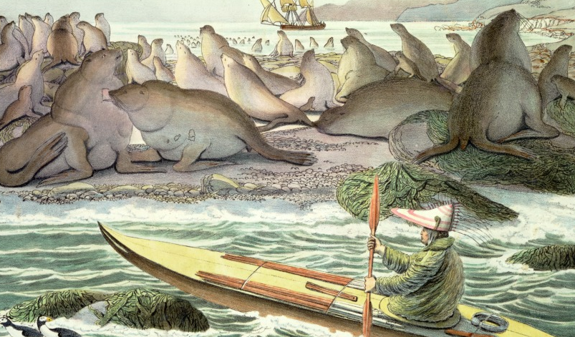
European hunters and trappers came to Alaska for Sea Otter fur
The first European hunters to arrive here were the Russian промышленники (Promyshlenniki)
Sea Otters and the Aleutian Islands
These promyshlenniki expanded eastward from Russia, throughout the Aleutian Islands
Russian fur hunters knew how to hunt animals on land, but not in the water. Instead, they relied on Alaskan native hunters as a labor source
Notes:
Yeah, very good! The abundance of fur, especially sea otter fur, here in Southeast Alaska brought European hunters and merchants from places like France, Great Britain, and Spain out of their colonies in North America and into coastal Alaskan waters. However, the first non-Alaskan native hunters to arrive here in Alaska actually came from Russia- on the top here, you can see a drawing of them dressed in warm furs and standing in a snowy forest, ready to hunt. On the bottom, you can see a photo of a Sea Otter- maybe you can tell from the picture how warm and soft their fur looks
In Russian, these hunters are called Promyshlenniki- I have the word written here in Russian, and I’d like us all to try and pronounce this word? Ready?
The first syllable we’re going to pronounce is “prom”
Give students a moment to copy
Next, we’re going to say “ooh”- instead of a long “moo” like a cow would say, try making that double “oo” sound way in the back and bottom of your throat (almost like you’d do when you do a Russian accent)
Give students a moment to copy
The third syllable is “shlen”- pretty easy one
Give students a moment to copy
And the last syllable we’re going to say is “ikki”
Great job everyone! Now, can we put it all together? “Prom-ooh-shlen-ikki”
So, we know that the Promyshlenniki started in Russia, and eventually wound-up hunting in the coastal waters of Alaska, but there was an in-between step for them, and a way for them to navigate their way across the Pacific Ocean in rickety, poorly made boats- bear in mind that the majority of these hunters were poor people who had limited experience in the water and many of them probably didn’t even know how to swim. And yet, they still set off across the cold and icy waters of the North Pacific in the search for these Sea Otters. ]
Now imagine, for just a minute, that you’re one of these hunters. You and a few of your fellow hunters have been at sea for days or weeks, facing hunger, thirst, cold, and the kind of wet that just seeps through your clothes into your bones. Now imagine how overjoyed you would feel when you see an island- and not only is this solid land but its full of people who, unlike you and your friends, actually are expert boat builders, navigators, and marine hunters. And, most importantly for you, you have technologies like guns and steel, and they don’t.
The promyshlenniki spread out from the eastern shores of Siberia and made their way into the Aleutian Islands that spread all the way across the Pacific Ocean between Russian and Alaska. Instead of having to make one long journey, these hunters could make dozens of smaller trips, hunting sea otters and resupplying as they went. On this top map that just appeared on the screen, you can see a map of the Aleutian Islands, and the ways that the Promyshlenniki spread out through these islands. In the Aleutian Islands, they also encountered a group of Alaskan native people that they called Aleut, but who called themselves Unangan. Through a system of intermarriage, indenture, and even outright violence, the promyshlenniki coerced, or forced, the Aleut people to work for them, hunting sea otters. Here, you can see images of Aleut people hunting close to shore, using their specially adapted technologies like kayaks, spears, and bentwood visors to operate close to shore, while the Russians are bound to their ships in deeper waters. This was a cycle that they continued for decades and decades- of overuse, and of the coercion of Alaskan native people.

Slide 5
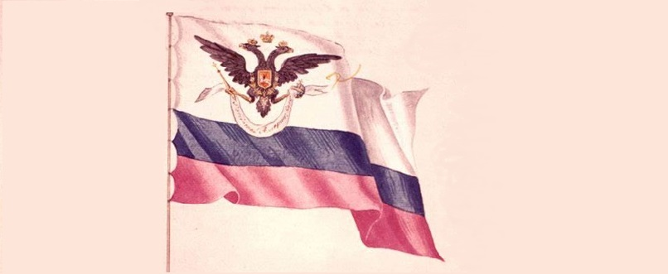
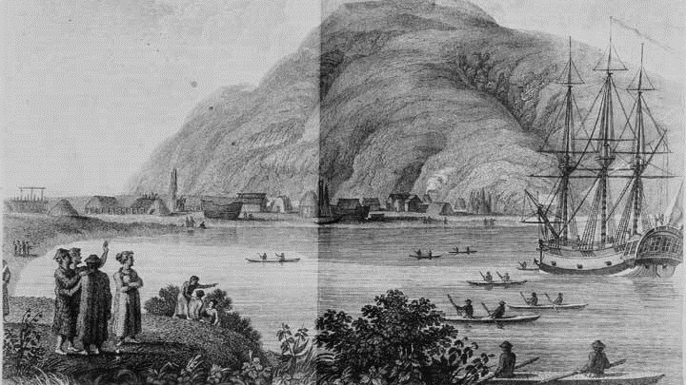
As sea otter populations fell, Russian promyshlenniki and their Unangan workers continued eastward into Southcentral Alaska
  The Russians coerced the Sugpiaq (or Alutiit) people they met in the same way they had the Aleut
For the first time, the Russians had to compete with other Europeans in Alaska
In response, the Russians increase their efforts to claim land and build permanent colonies
In 1799, the Russian Tsar established the Russian American Company to increase cooperation among Russian trading efforts
Settling in Alaska
Notes:
Eventually, Sea Otter populations in the Aleutian Islands began to fall- and so the Russians and their Unangan workers were forced to move on to Southcentral Alaska to hunt for more sustainable populations- and there, they met another group of Alaskan native people that they called Alutiit, but whose name for themselves was Sugpiaq.
But the Sugpiaq weren’t the only people the Russians found themselves dealing with in mainland Alaska- they also began to encounter other European hunters. Can anyone guess some of the countries that these hunters were coming from, and where they’d been before coming to Alaska? We talked about it very briefly just a minute ago, so we’re doing a little pop-quiz to see who was paying attention- there’s three specific answers I’m looking for.
That’s correct! The Russian promyshlenniki began encountering British, French, and Spanish traders and hunters the further east and south they went in Alaska- and that worried them. They understood exactly how profitable sea otter fur was and would continue to be. They thought that the presence of other Europeans here in Alaska would weaken their own “claim” on this land, never mind the fact that the Alaskan native people they had encountered along the way were really the true owners of this place.
In response to these other Europeans, the Russians really started to ramp up their efforts to establish permanent settlements, outposts, and bases of power here in Alaska, in the places they knew Sea Otters could be found. This picture that we’ve been looking at while we’re talking is a drawing of the Russians and their Unangan employees arriving on Kodiak Island, which is located in Southcentral Alaska. In 1784, one of the wealthiest and most successful Russian fur trading companies established the first permanent Russian settlement in Alaska here, which they called Three Saints Bay.
Now, the word choice here is important. I said one of the wealthiest and most successful trading companies. That’s because, as I’m sure you can probably guess, there were A LOT of these companies being formed, going and hunting for a year or two, and then dissolving after their voyage was complete. In the Aleutian Islands, this was fine- the Russians had no one else to compete with, and no threat to their claim on the land. Like we’ve talked about, that changed when they got into Southcentral Alaska- suddenly, all of these small companies couldn’t compete with larger, better organized, better funded, and better equipped trading companies (especially the British, who had the huge Hudson’s Bay Company that was located in Canada).
In response, the Tsar Paul I, who’s title is equivalent to something like a king or emperor, founded the Russian American Company in 1799. Here, you can see the flag of the Russian American company, with the traditional Blue, White, and Red of the Russian flag, and the double-headed eagle, which was the symbol of the Russian imperial family. The Russian American company was a state-owned company, which meant the government was entitled to a significant portion of the company’s profits. In exchange, the RAC was given a monopoly on fur trading in Alaska, meaning only employees of that company were allowed to hunt and trade Sea Otter fur in any Russian territory in Alaska- and again, we know this territory was rapidly expanding because for the first time they were doing what? Who can tell me?

Slide 6
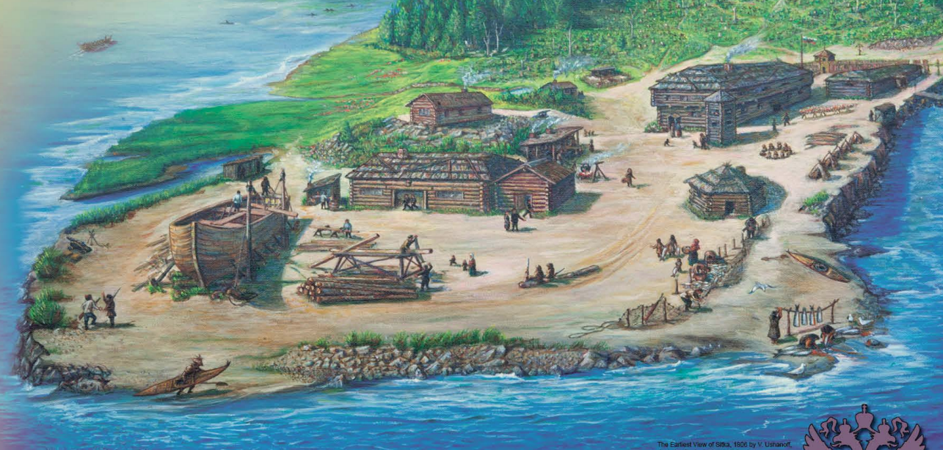
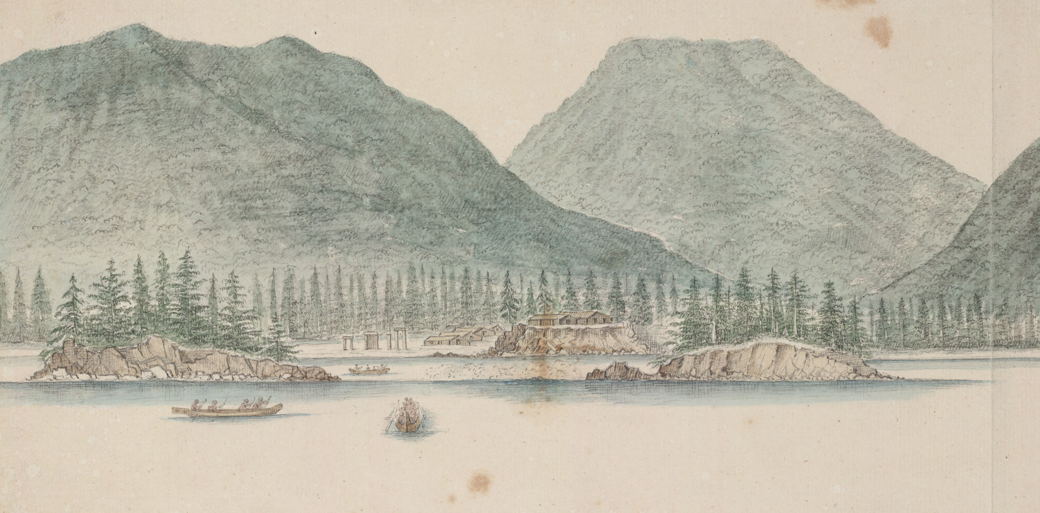
Among the locations the Russians wished to build a colony was right here on Shee.
Settling on Tlingit Land
The Tlingit had lived in this area for thousands of years, and were not eager to have the Russians and their Alaskan native workers settled nearby
After much negotiation, the Russians were eventually granted a site roughly 7 miles down the shore from Shee Atika, where in 1799 they constructed a fur-trading outpost called Saint Michael’s Redoubt
Notes:
Yes, very good! And among the locations the Russian American company wished to build a settlement was right here, on Shee- again, a traditional home of the Tlingit people and the very same place that Sitka National Historical Park is now built. They had lived on this land for thousands and thousands of years, and they definitely weren’t eager to see the Russians and their Alaskan native allies settle so close to the village that you see in this image here.
This drawing, which is from 1793, is of Shee Atika, the Tlingit village that existed right here on Shee before the Russians arrived. I have a question for all of you- has anyone here ever had an experience when you see a picture of a place that’s familiar to you, but taken some time in the past? For example, maybe you’ve seen baby pictures of yourself at your own house or maybe a grandparent’s house, and had the thought that “this place is so familiar, but also looks very different now that time has passed”? Well, that’s how I feel looking at this drawing. Of course, the village of Shee Atika is gone today, and has been replaced by the City of Sitka- but if I were to go on a walk through town right now, I would still see these mountains you see in the background, or these islands that you see in the harbor. Just like the pictures you’ve seen and are thinking of, historical photographs and drawings like this one are excellent reminders that, even though these places and these people change, there’s always something familiar about them if you look, and there’s always something to learn.
In 1799, after negotiating with the Tlingit, the Russians were eventually granted the use of a site roughly 7 miles down the coast from Shee Atika, at a seasonal fishing camp the Kiks.ádi called Gajaa Heen. The Russian American company constructed a fur trading outpost there, which they called Redoubt Saint Michael. Here, you can see an artist’s rendition of the outpost, depicting what life might have been like there and what kind of buildings and enterprises were underway.

Slide 7
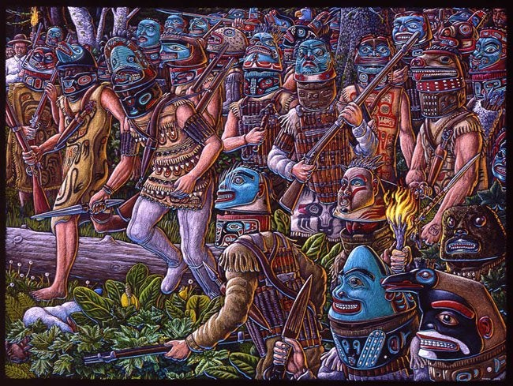
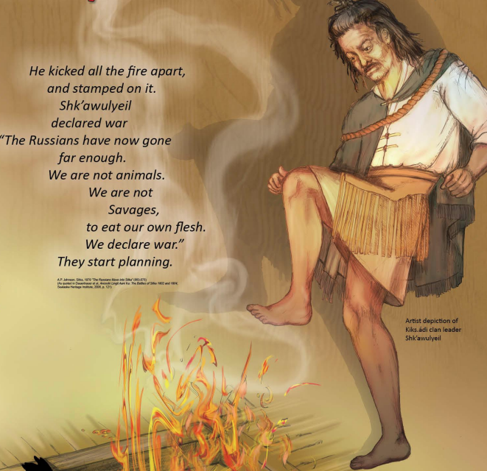
The period between 1799 and 1802 was not a peaceful time for the Russians, their Alaskan native workers, and the Tlingit.
The Battle of 1802
This outrage led to violence in 1802, after an event described in Tlingit Oral History
In response to this event, the Tlingit of Shee gathered their allies from across South-east Alaska and retaliated
Notes:
And yet, despite the fact that negotiations between these two different peoples, the period between 1799 and 1802 was anything but a peaceful time for the Tlingit of Shee, the Russian promyshlenniki, and their Aleut and Alutiit allies. A large part of this comes from the cultural and linguistic foot that these groups stood on. Who here has ever been somewhere with a different culture, and/or spoken to someone who did not speak the same language?
Have students raise their hands, maybe give an example or two if there’s time
In any negotiation, people bring their own languages, ideas, and cultural biases to the table- factors that the other negotiating party can’t or won’t understand. This was definitely the case in 1799. While the Tlingit may have agreed to give the Russians this plot of land and access to the river, they certainly did not agree to let the Russians overhunt and overuse the resources of their land, the traditional resources they used yearly and required to live their lives, and they did certainly did not agree to join the cycle of abuse, assault, disregard, and disrespect that the Russians began with the Aleut and Sugpiaq peoples, and attempted to continue here in the Southeast.
In 1802, after an event described in Tlingit oral history, this growing outrage eventually erupted into violence. According to this story, there was once an elderly Russian man had been forced out of Saint Michael's Redoubt due to his age and frailty. In compassion, he was taken in and cared for by a Kiks.ádi clan leader named Shk’awulyeil and his family until he died. Afterwards, they returned his body to the Russians, so he could be buried in the proper custom. In “thanks”, the Russians invited Shk’awulyeil and his family to a feast; a feast in which they were served “awful tasting meat”. Not wishing to be impolite, they ate the meat but discovered afterward that it had been cut from the body of the old man, which outraged and offended the Tlingit. Shk’awulyeil, his sons, and nephews returned home and forced themselves to vomit- in Tlingit culture, cannibalism is seen as an ultimate taboo, and this incident could not go unpunished. Shk’awulyeil met with other important Tlingit leaders like Kalyaan/Katlian, the war leader of the Kiks.ádi, and Stoonook, an important Tlingit shaman, and together they declared war. In this picture, you can see an artist’s depiction of Shk’awulyeil stamping out the fire and declaring war on the Russians- there is a quote here that, unfortunately, has been cut off, but it reads “The Russians have now gone far enough. We are not animals. We are not savages, to eat our own flesh. We declare war.”
The Tlingit called upon indigenous people from across Southeast Alaska- both Tlingit and Haida clans, several of whom were traditionally enemies of the Kiks.ádi, responded. Hostilities aside, none were eager to see the Russians expanding into Southeast Alaska. The unique family structure of the Tlingit people that we discussed earlier, and the importance of family to their culture, ensured that their allies, many of whom were brothers, cousins, uncles, etc. would come.
In June of 1802, in carefully planned ambushes lead by Katlian, the Kiks.ádi battle leader, the Tlingit and their allies burned Saint Michael’s Redoubt to the ground and killed or took hostage the majority of its inhabitants, including women and children. They also ambushed the various hunting parties that were out searching for sea otters, killing most. In this artist’s depiction of this ambush, you can see the Tlingit dressed in their traditional armor with intricately carved battle helmets, with several carrying traditional weapons like daggers, and others carrying guns. When the violence was over, only a few Russians and Alaskan native workers, and the families of these people, had survived by hiding in the woods when the Tlingit began their attack. These survivors were rescued by a passing British captain named Henry Barber his ship, The Unicorn. Unfortunately, Barber kidnapped the survivors and forced the head of the Russian-American company, Alexander Baranov, to pay him a ransom for their return.
Here is a unique opportunity for some critical thinking- where do you think the Tlingit and other native people in Southeast Alaska were acquiring firearms? It certainly was not the Russians- why would they want to arm a group of people that they knew could pose a threat to their interests?
Wait for students to respond
Yeah, very good! The Tlingit were being armed by other European traders like the British, who wanted to establish their own outposts and settlements in Southeast Alaska. They couldn’t just outright attack the Russians themselves without creating an international incident, but they could convince the native people to do their dirty work for them, and supply them with the weapons they needed to do it. I want you to remember this- getting others to do your fighting for you is a “trick” that civilizations across the globe have done for all of history, in order to advance their own interests while seeming impartial. “Western” civilizations do this all the time- even America. In fact, many of the guns that the British were trading to the Tlingit originally came from America- “Brown Bess” muskets were supplied to soldiers during the Revolutionary War, and just thirty years later they were showing up in the hands of the Tlingit who battled the Russians. It’s important that we keep our eyes open to these important historical connections- without them we all have trouble seeing and understanding how the world is being shaped around us.

Slide 8
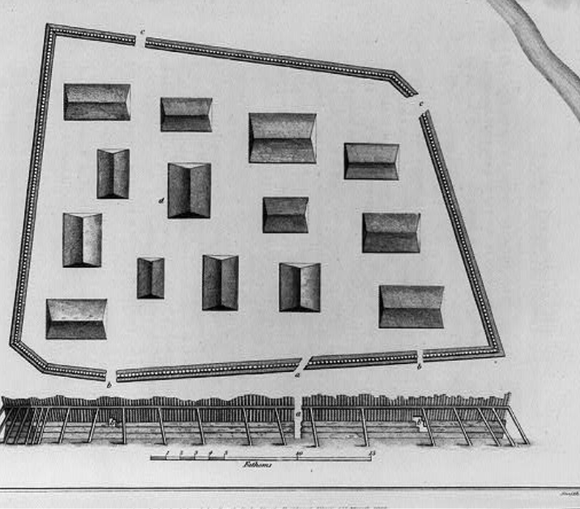
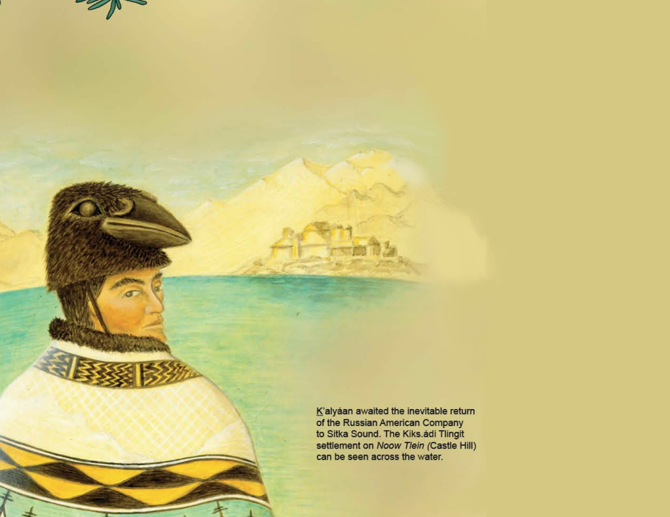
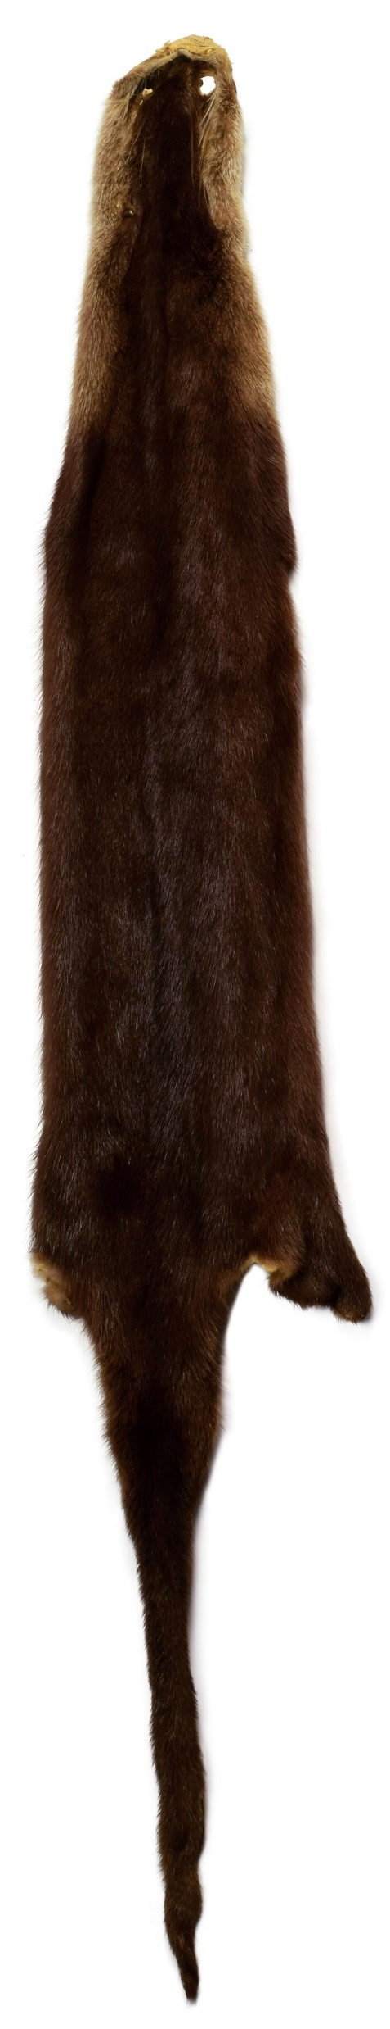
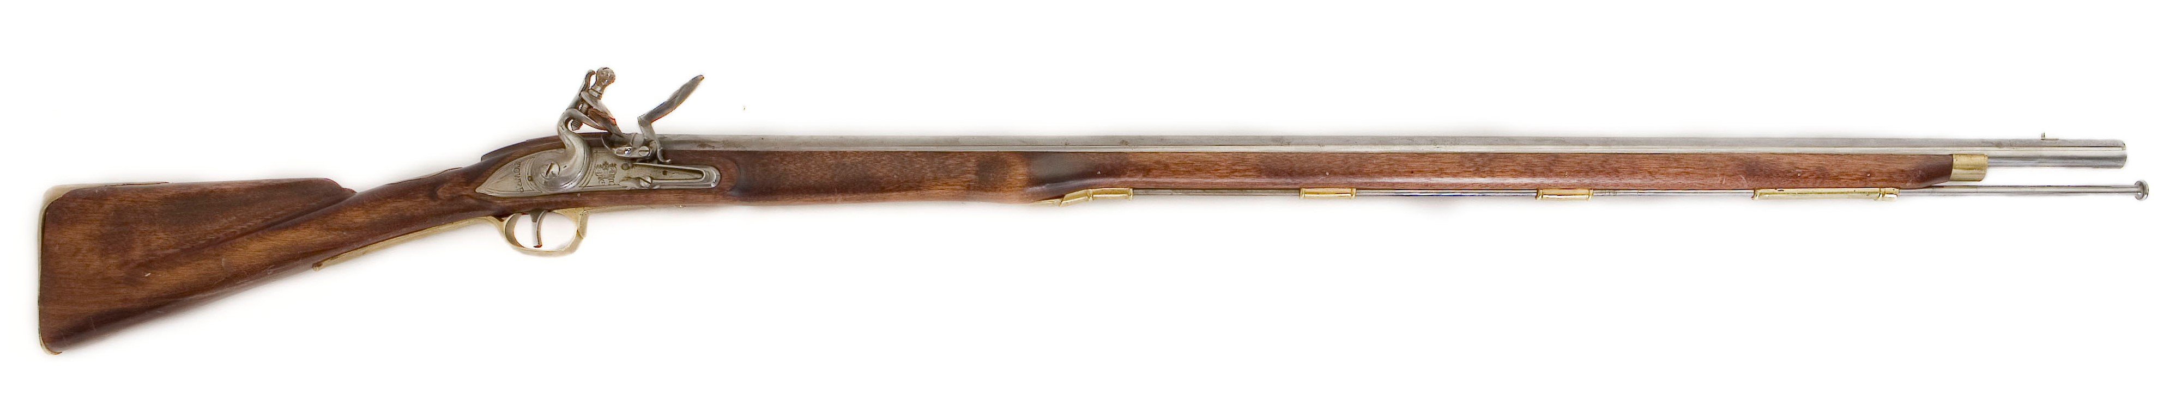
After the Battle of 1802, the Tlingit knew that the Russians would eventually return
With Saint Michael’s Redoubt gone, the Tlingit began preparing for a counter-attack
Preparing for Conflict
They constructed a new fort at the head of the Kaasda Heen, or the Indian River
They began stockpiling weapons, powder, and ammunition for the coming battle
What did the Russians do during this time?
Notes:
So do we all understand that the “Battle of 1802” was less of a battle, and more of a series of ambushes- the Tlingit did all the fighting, and the Russians did all of the losing.
Give students a moment to respond
In the aftermath of this battle, the Tlingit knew that the Russians would eventually come back. They knew that, despite their losses, the Russians would not be able to resist the abundance of resources and strategic bonuses that this land could offer. With Saint Michael’s Redoubt, and it’s Russian, Aleut, and Alutiit occupants gone, the Tlingit began preparing. In this drawing, you can see Katlian standing across the water from the village of Shee Atika. The question is- how did they go about doing this?
First and foremost, the Tlingit realized that their village, Shee Atika, was not an ideal place to resist an attack. Remember- the Tlingit had guns and cannons of their own, and knew what kind of damage such weapons could do. In light of this, the Kiks.ádi elected to build a new fort at the head of the Kaasda Heen; one designed to resist cannon-fire and repel a Russian advance. They called this fort Shis’gi Noow. In this drawing that just appeared here on the screen, you can see a drawing of Shis’gi Noow that was made shortly after the Battle of 1804- but we’ll talk about that in a minute. You can see that the fort was a series of long walls surrounding clan houses built within them.
Can everyone take your arms and put them out in front of you, like a hoop?
Give students a moment to follow this motion
Very good! Now, even though this is a little bit strange I promise there’s a reason we’re doing this. Imagine now a tree growing in the middle of your hoop; a tree that just large enough that your fingers would touch if you wrapped your arms around it. The Tlingit called trees of this size Shisk- can everyone say that with me? Shisk
Give students a moment to repeat
The fort, Shis’gi Noow, was a fort made out these Shisk sized trees- these trees were young and green, and instead of absorbing the impact of a cannonball and shattering, these young and flexible trees would reflect the impact of the cannonball and force them to bounce off. In addition, the Tlingit angled the walls of the fort, so the cannonballs would bounce even further. So, the name Shis’gi Noow, when you translate it to English, literally means something like “The Fort of Young Saplings” or “Fort of Young Trees”.
In addition to the fort’s design, the location they chose was also strategic; they built the fort at the mouth of the Kaasda Heen, or the Indian River. Today, we call the site of this fort and the land surrounding it part of Sitka National Historical Park, but for thousands and thousands of years the Tlingit used this place for fishing and gathering berries. In addition, they knew that the shallow waters surrounding the river’s mouth would make it so the Russians couldn’t bring their ships in close and use their cannons at their most effective range.
So to summarize, the Tlingit had built themselves a fort that was: outside of the Russian’s effective cannon range, resistant to cannonballs if it came to that, and had easy access to food, water, and medicines. Overall, a great decision.
Another way the Tlingit prepared was by stockpiling their supplies- they knew that everything from extra food to spare gunpowder was going to be important. On the screen here we see a picture of a musket- this is one of those “Brown Bess” muskets I was talking about earlier; surplus weapons from the Revolutionary war traded to the Tlingit by Americans and British, who wished to see the Russians stay gone from Southeast Alaska. Although they had their own reasons, for now their interests aligned with the Tlingit.
The Tlingit stored their supplies the harbor islands that dot Sitka Sound- there wasn’t enough space within the walls of Shis’gi Noow. Plus, raise your hand if the idea of storing a lot of explosive powder, next to all of your to all your weapons, food, and supplies, and all of your people, in a fort that will (probably) get shot at in the near future isn’t too appealing of an idea. In addition, storing supplies on these islands meant that, if the Tlingit could not get to Shis’gi Noow or had to retreat, they wouldn’t lose these hidden caches.
So now that we know a little about how the Tlingit prepared for this battle, how do you guys think the Russians used their time? What kinds of preparations did they make?
Call on students to make guesses
This was actually a trick question- the real answer is that the Russians didn’t really do a whole lot. The important thing to remember about this whole ordeal is that for the Tlingit, this was their home; this was their land and they were willing to die to protect it. For the Russians, this was just a place- a place with a lot of Sea otters, sure; but at the end of the day, there were other places with sea otters in Alaska. Between 1802 and 1804, the Russian American company was still around, and still had a duty to the tsar to make money. So, although today we really frame these Battles as some kind of grand conflict between these Russian hunters on one side and the Tlingit warriors on the other, in reality the Russians couldn’t have cared less about this land- they knew they’d be back here for the resources, but what did it matter to them if it took a few years? In the meantime, they still had their hunting parties, they still had their settlements, and they still had Sea Otters- you can see an example of a sea otter pelt in this picture in the bottom left.

Slide 9
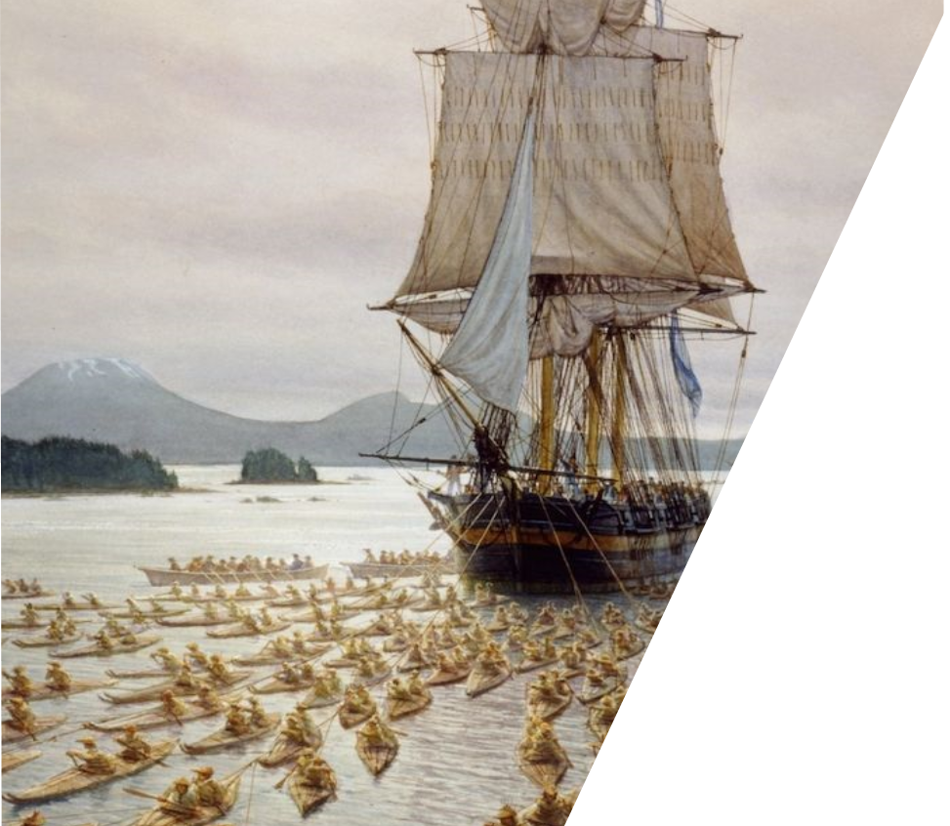
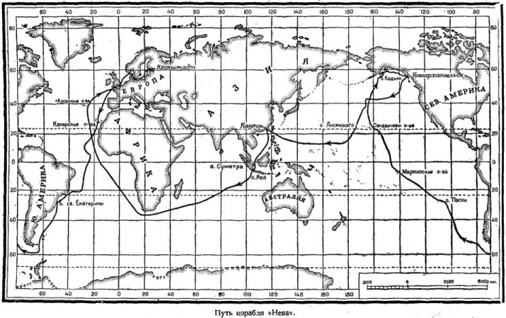
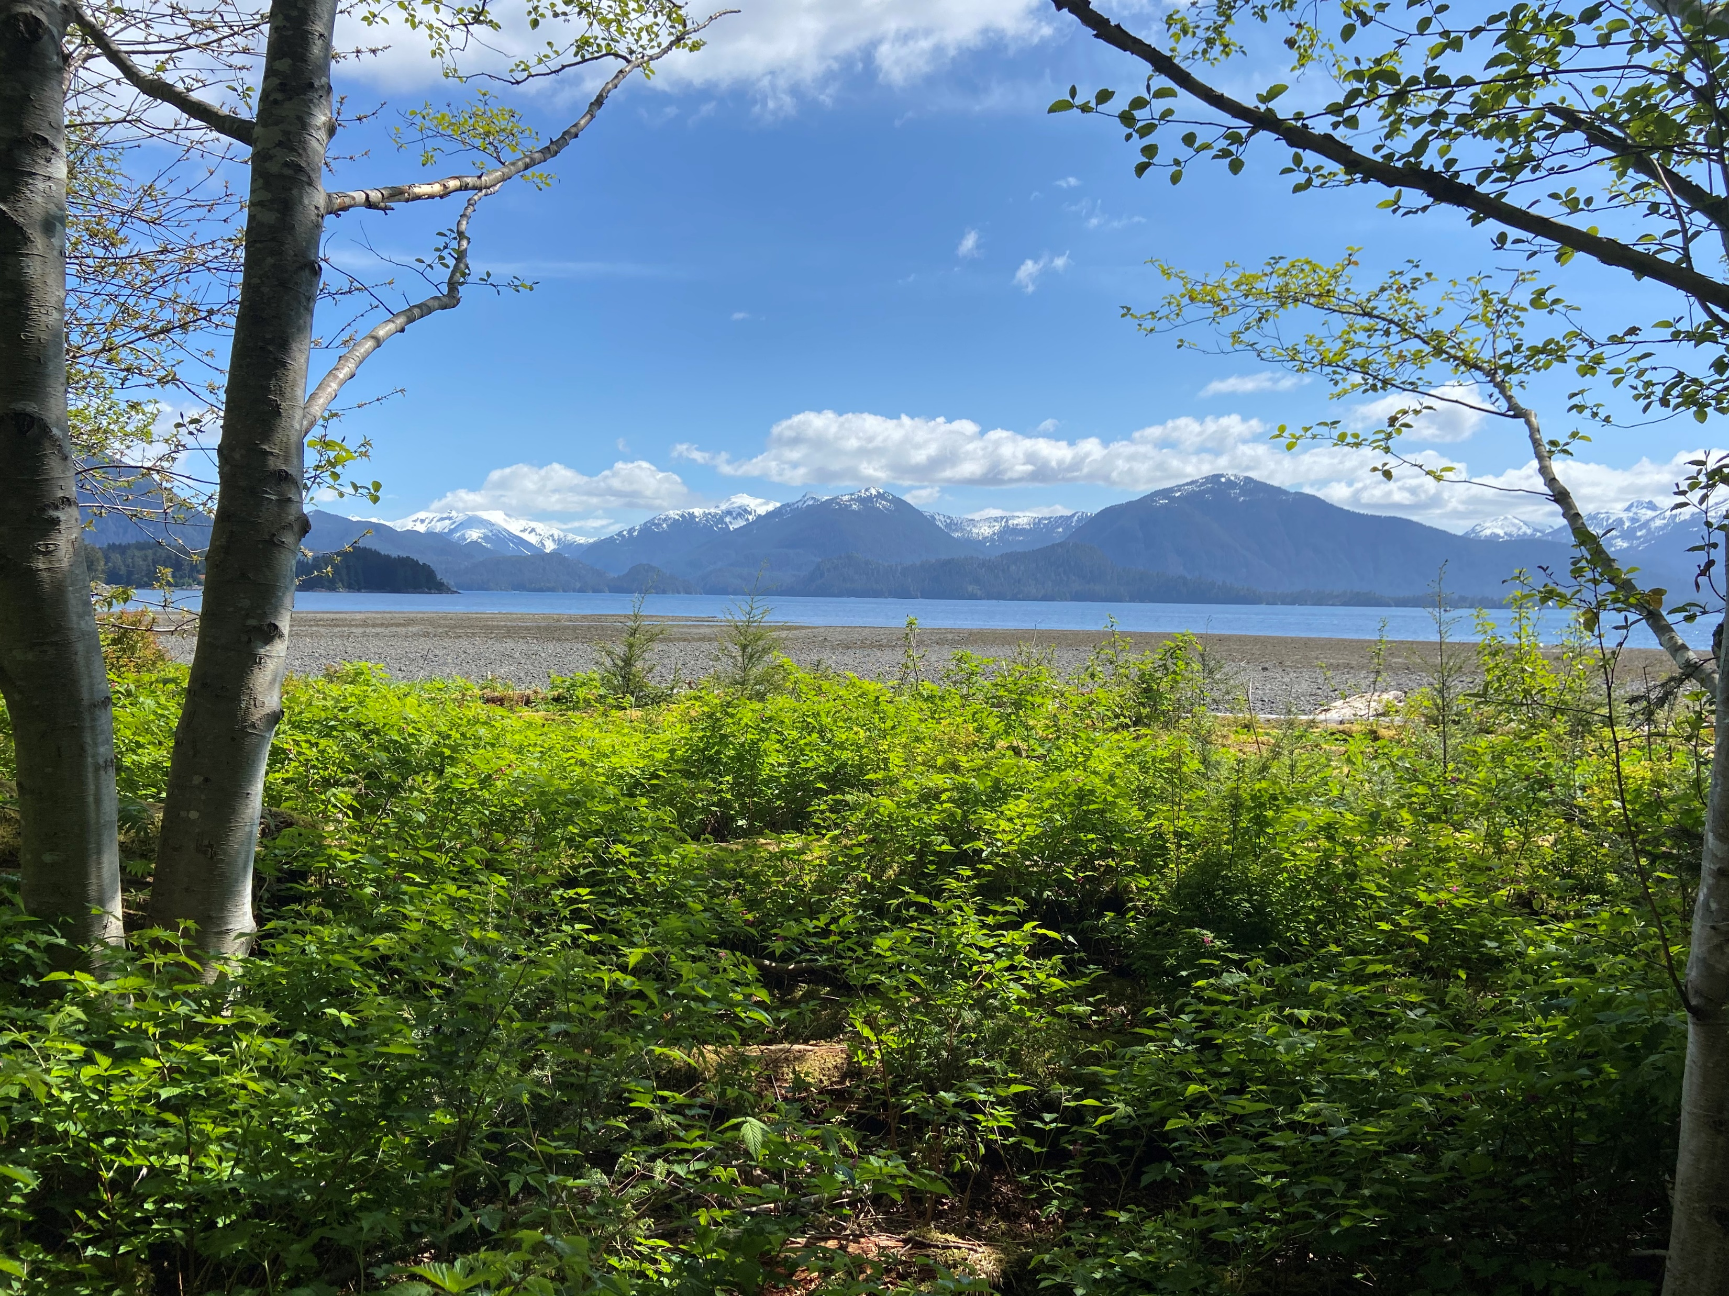
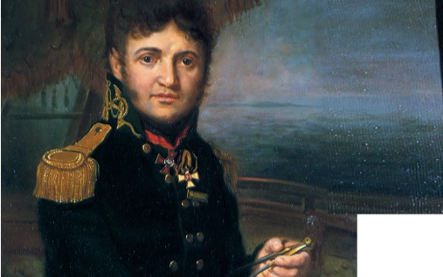
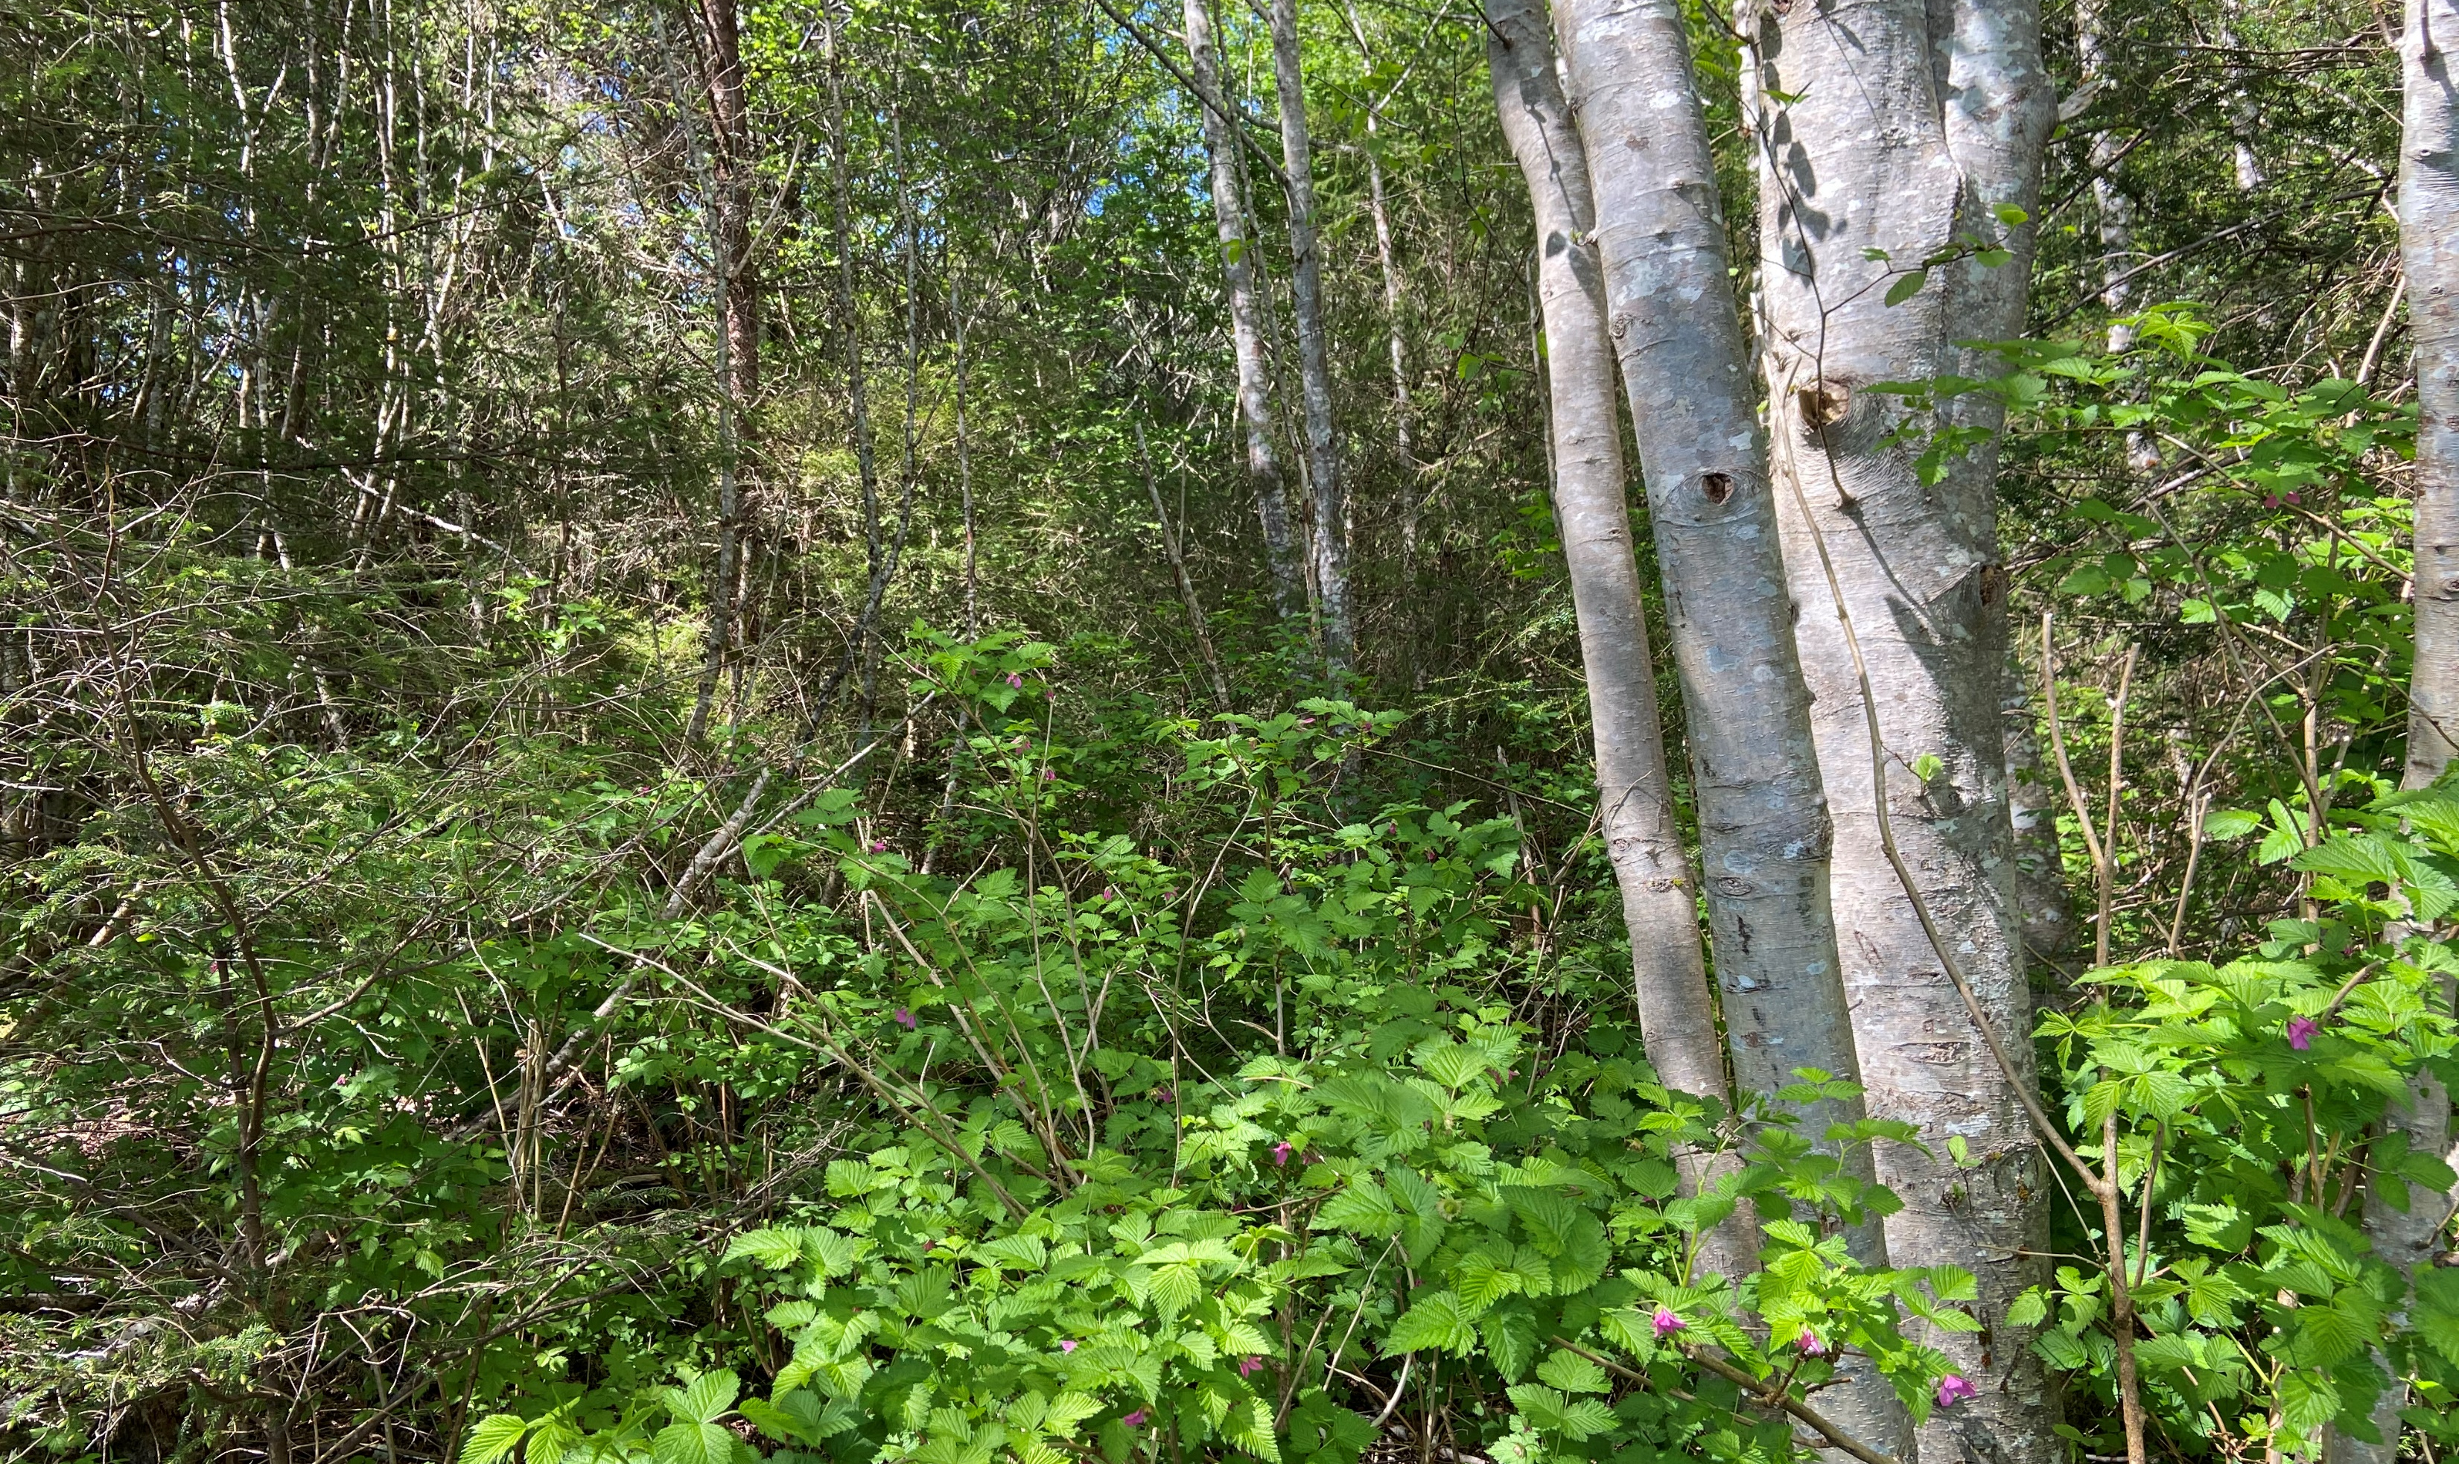
In the fall of 1804, the Russian American company returned to Shee for the first time in two years
  They brought with them hundreds of promyshlenniki and Alaskan native hunters
The Russian forces were aided by a Russian naval warship called the Нева (Neva)
The Battle of 1804
On September 28th, 1804, this combined force arrived at Shee Atika. The Tlingit’s preparations had paid off- they knew the Russians were coming and had already moved into Shis’gi Noow
The Russians attempted to land and assault Shis’gi Noow
Lisyanski elected to lay siege to the fort, and for 4 days these two groups returned fire; the Russians from the Neva, and the Tlingit from Shis’gi Noow
Running low on supplies, the Tlingit sent their best warriors to retrieve their extra gunpowder and cannonballs
Notes:
In the fall of 1804, the Russian American company returned to Shee for the first time in over two years, and they brought a veritable army with them. Dozens of Promyshlenniki aboard Russian American Company vessels, and hundreds more of their Alaskan native hunters and workers alongside them in their baidarkas. The Russian forces were also aided, quite fortunately for them, by a fully trained and well equipped Russian Naval warship called the Neva. The Neva, and its sister ship called the Nadezhda, had both been sailing around the world over the past few years. In this top map, you can see the route that the Neva took outlined in red- they left Russia, sailed around South America, up through the Pacific ocean stopping at places like Easter Island and Hawaii, and then and then headed north to Kodiak Island, the Alaskan headquarters of the Russian American company; they caught up to Baranov and his forces shortly after they left to return to Sitka, and offered their much-needed help.
Now, why do I say much needed? First and foremost, although the Neva was not a huge warship, it still brought a full crew of highly trained Russian sailors and 14 cannons, which was a huge bonus for Baranov’s forces. The primary advantage it brought, however, actually lies in the fact that these were Baranov’s forces- and while Baranov was an excellent businessman and director of the Russian American Company, he had no experience as a soldier or a sailor. The Neva brought the expertise of its commander, Yuri Lisyanski, who was a career soldier and military officer. On the bottom, you can see a portrait of him dressed in a naval uniform and standing on ship in the water. He brought military experience that, as we’ll come to find out, would play a pivotal role in the battle to come.
On September 28th, 1804, Baranov’s force and the Neva arrived in Sitka Sound. The picture that you see here on the screen, of the Neva being pulled by Alaskan native people in their baidarkas with several islands and Mt. Edgecumbe (the dormant volcano located just outside of Sitka Sound) in the background- on the morning the Russians arrived back in Sitka, there was no wind so instead of sailing in, they actually had to be towed by upwards of 400 of their Alaskan native workers. They were towed all the way through Sitka Sound, right up to the village of Shee Atika, where the Russians expected to find the Tlingit fortified and waiting for them- instead, they found the village completely empty. The Tlingit’s preparations had paid off, and instead of remaining in the village, which was within the range of Russian cannons, they had already moved into Shis’gi Noow, where the shallow waters surrounding the mouth of the Indian River prevented the Russians from using their cannons accurately or effectively. On October 1st, 1804, two days after their arrival, the Russians began their attack.
The Russians attempted to land their troops and assault the fort via the ground, but again because of the geography, could only land a limited number of troops at a time. Their first assault failed miserably- the Tlingit fired on the Russian American company troops as they approached, and then engaged the panicked survivors in hand-to-hand combat, killing much of the first wave. Here on the screen, you can see an artist’s depiction of this first assault- this main figure in the center here is Katlian, wielding a blacksmith’s hammer as a weapon. He actually took this hammer from the blacksmith at Saint Michael’s Redoubt- the first person killed in the Battle of 1802. Today, this hammer is an incredibly important cultural artifact for the Kiks.ádi, and they have loaned it to us to display here in our park museum- so if you ever come visit Sitka National Historical Park, you’ll actually be able to see this hammer, and experience this piece of history for yourself.
I’d like you all to look at these pictures that just appeared on the screen- I took these from within Sitka National Historical Park, not far from the site of Shis’gi Noow near the mouth of the Indian River. On the top, I have a picture of the view you would see looking out towards the water with your back to the forest, with a gravel beach leading to the water before it rises back up into the green mountains. On the bottom, I have the opposite view- a picture taken with you back to the water into the forest. From the forest, how much of the water can you see- how clear is the view?
Have students respond
And now what about the opposite? From the water, how deep into the forest can you see?
Have students respond
Imagine being one of the Russian sailors, or promyshlenniki. You’ve been at sea for weeks getting here, and then you’re instructed to disembark and march into this dark, foreboding forest where you know an enemy is waiting for you; an enemy who has lived and thrived in this forest for thousands and thousands of years, and who you know can probably see you coming even though you have no idea where they are. It’s a terrifying thought- but it shows exactly how well prepared and tactically Tlingit were despite the fact that the Russian American Company were completely dismissive of them and other Alaskan Native people; just a thought to keep in mind.
In this first assault on the fort, Baranov was actually shot and injured (you can see him in the bottom corner of this picture) and had to be evacuated back to the Neva. And although this might have seemed like a key victory for the Kiks.ádi, it actually allowed Lisyanski, the seasoned military commander, to devise and implement his own, much more effective plan of attack.
Rather than attacking the fort directly, Lisyanski instead knew that he could simply wait out the Tlingit- although they were positioned very well, he knew they would eventually run out of food, gunpowder, and ammunition. Lisyanski chose to remain aboard the Neva, and lay siege to the fort with his cannons- not enough to destroy Shis’gi Noow, but enough to remind the Tlingit that they were waiting for them.
This went on for days, until eventually, Lisyanski’s theory proved to be correct. The Tlingit were beginning to run out of supplies; but unbeknownst to him, they had planned for this. Among their preparations, the Kiks.ádi had stockpiled extra weapons, gunpowder, ammunition, and food on a nearby island, and under the cover of darkness, they sent out their best warriors in a canoe to go retrieve them. However- after retrieving their supplies tragedy struck. On their return trip, some sort of accident occurred aboard the canoe with the supplies, resulting in the gunpowder they had aboard lighting. In a moment, the Kiks.ádi’s continued hope of victory went up in smoke- along with all of their gunpowder, ammunition, and food, the greatest warriors of an entire generation were destroyed in the blast.

Slide 10
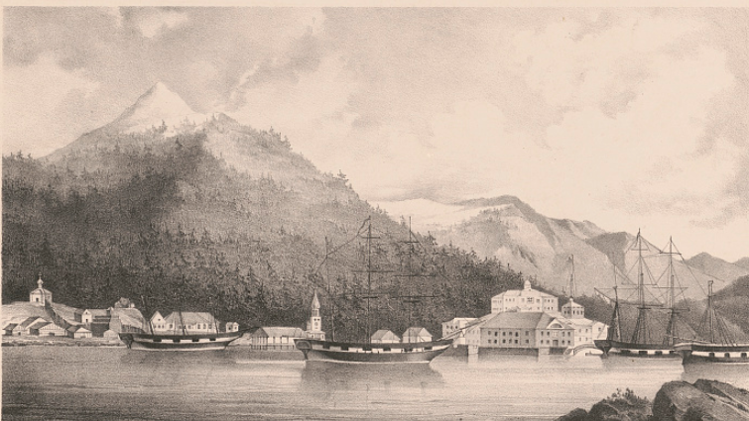
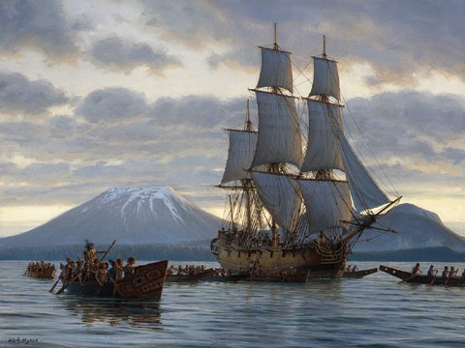
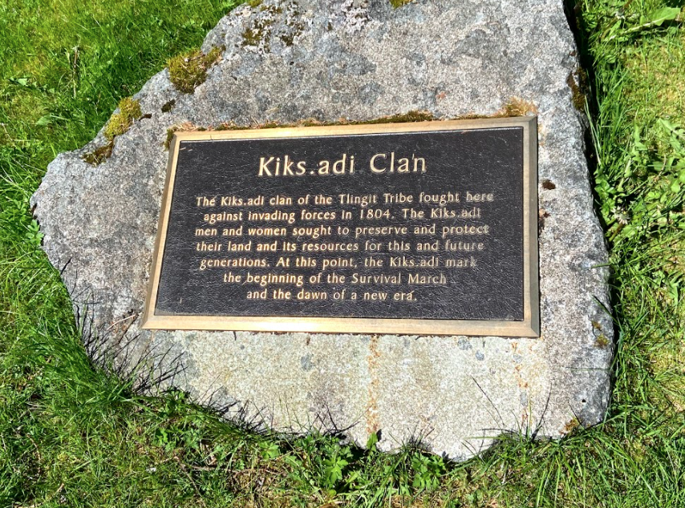
The Tlingit were faced with a choice: Stay and continue their fight, or leave and preserve themselves
The Tlingit chose to leave on their “Survival March”
The Russians turned Shee Atika into a new colony called Ново Архангельск (New Archangel)
The Survival March, New Archangel, and the Tlingit blockade
The Russians control of Shee (Baranof Island) was very limited
The Tlingit cut off the Russians supply of food with a 20-year blockade
In 1823, the Tlingit returned to their traditional home and rebuilt their village and clan houses outside the walls of New Archangel
Notes:
The Tlingit were now faced with a choice; without their supplies or warriors, their chances of victory in this battle were not assured- but they still had a highly defensible position and were willing to fight for their home. On the other hand, they had already sacrificed much, and after days of fighting the people in Shis’gi Noow were tired, hungry, and scared.
In the end, the Tlingit elected to leave Shis’gi Noow during the night, evacuating their people to another part of the island- today, the Kiks.ádi call this period of their history the “Survival March”.
This is a photo of a plaque that stands in the fort site memorial in Sitka National Historical Park- it reads “The Kiks.ádi clan of the Tlingit Tribe fought here against invading forces in 1804. The Kiks.ádi men and women sought to preserve and protect their land and its resources for this and future generations. At this point, the Kiks.ádi mark the beginning of the Survival March and the dawn of a new era”.
Now, there’s something important about what isn’t written on this plaque- when the tribe put this in place, their choice of words was very intentional. Can anyone tell me what kind of language doesn’t appear here that some people might expect?
Yes! Very good- this plaque does not mention at all the Battle of 1804 ending, either in defeat or in victory for either side. It is important to realize that their decision to leave was not a defeat- they could have continued fighting, but left in order to preserve their culture, their people, and to continue to make the lives of the Russians miserable- and in this, they were more than successful.
After the battle of 1804, the Russians were quick to turn Shee Atika and the surrounding Kiks.ádi lands into a secure and profitable colony that they called Ново Архангельск, or New Archangel. By constructing blockhouses (one of which has been rebuilt and can be seen in downtown Sitka today) and fortifications linking them, the Russian colony of New Archangel became a relatively safe and strong example of Russian imperialism and colonization. You can see a drawing of the colony from the 1850’s on the screen, with a large building build on top of what we call “Castle Hill” with several ships out on the water.
However- this example was, in actuality, incredibly limited to the area within the walls of New Archangel and the immediately beyond them. The rest of Shee, which the Russians renamed Baranof Island, was Tlingit land. The Kiks.ádi, who had regrouped and rebuilt, controlled the land and its resources. Every time the Russians left the relative security of their fortifications, they risked their lives. In addition to their inability to utilize the land and its resources, the Tlingit were also determined to make shipping and receiving goods into the colony as difficult and dangerous as possible. For nearly 20 years, the Kiks.ádi maintained a kind of blockade in the waters surrounding New Archangel, both warning away and fighting off ships that sought to approach and trade with the colony.
Over time, the actions of the Tlingit even created a food crisis within the colony, as the Russians could not farm on the land, hunt in the hills, and the number of supply ships that could make it to the island was limited by the blockade.
In the 1820’s, the Russians eventually grew so fed up and tired with the Tlingit making their lives miserable that they sued for peace and sent envoys to their new settlement, hoping for some reprieve. The Kiks.ádi negotiated peace on their own terms, and when they were ready, returned to Shee Atika and rebuilt their village and clan houses just outside the walls of New Archangel- thus, in 1823, the “Battle of 1804” officially ended with an uneasy peace between old enemies.

Slide 11
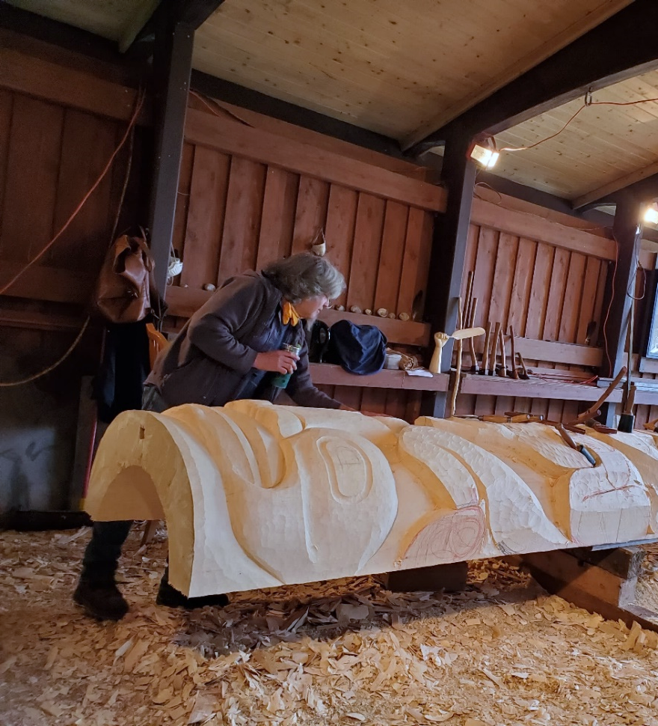
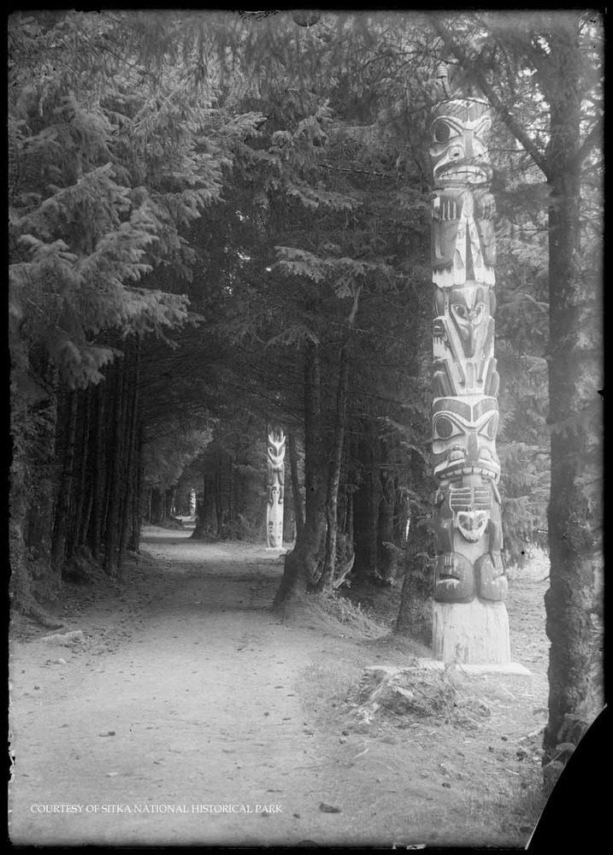
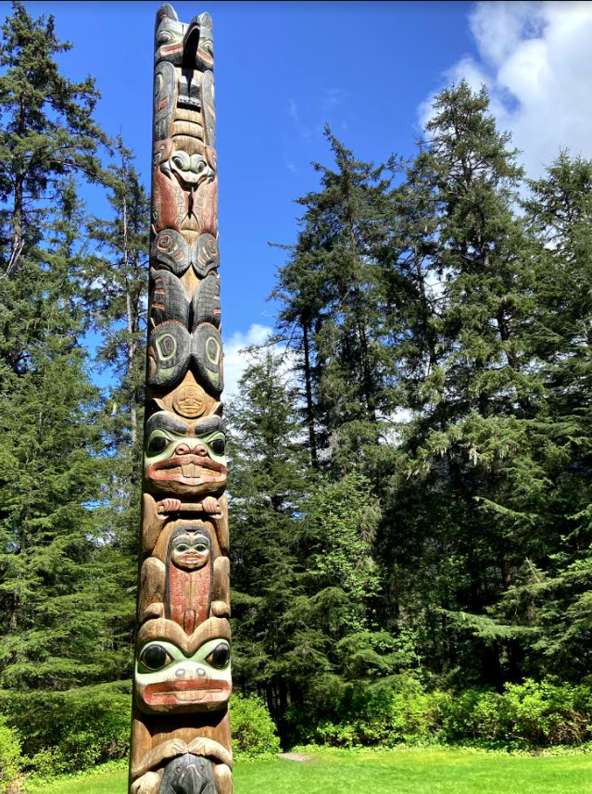
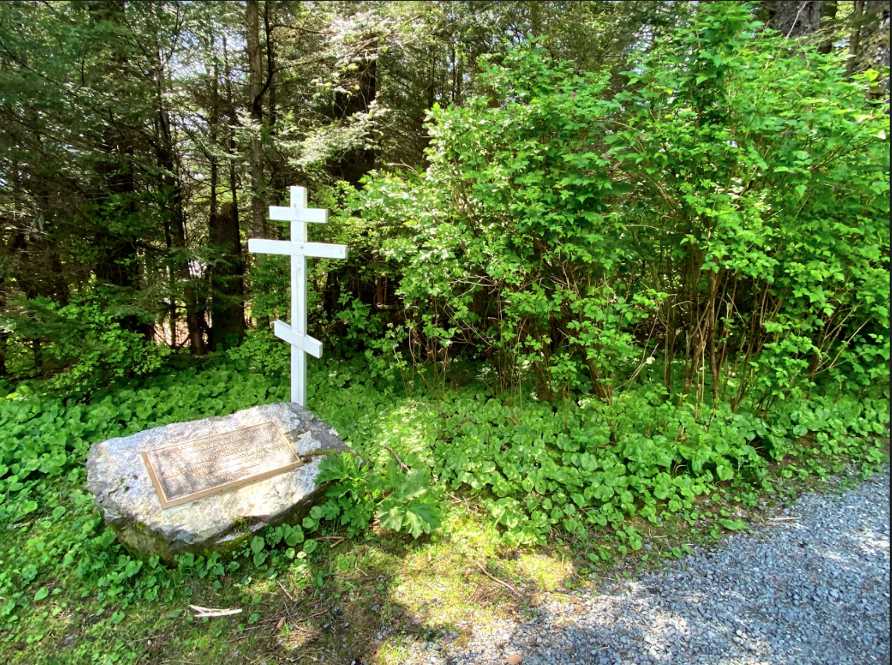
The National Park Service work to preserve and protect the legacy of the important cultural and historical events
Our park exists due, in no small part, to the actions that occurred here during the Battle of 1804
The Russians preserved this land after the Battle of 1804
Because the Russians preserved it, so too did the Americans
The Legacy of Conflict in Sitka:
Remembering the Battle of 1804
Preservation meant this place became home to Governor Brady’s collection of Totem Poles
Our collection of poles makes our park an important place for the practice and preservation of Alaskan Native art and culture
Our Park is a testament to the history and the legends of the peoples that have lived and died in this place; by preserving their stories, memories, and identities, we recognize our own history of conflict while also acknowledging our ability to make peace
Notes:
Here at Sitka National Historical Park, every day we work to preserve and protect the legacy of important cultural and historical events that took place not only right here on the land in our park, but throughout the city of Sitka and Southeast Alaska as well. This pole you see on the screen is called the “Kalyaan Pole”. In 1999, it was raised at the site of Shis’gi Noow to memorialize the battle of 1804 and bring closure to both the Tlingit people and the descendants of Russian survivors of the battle.
The reasons our park exists are all in no small part due to the actions that occurred here during the Battle of 1804- because the battle occurred here, the Russians preserved this place. This is a photo of the “Russian memorial” within our park- a simple Russian orthodox cross and a plaque that reads “Erected in memory of the Russian sailors and Aleut hunters killed during the battle with the Kiks.ádi clan of the Tlingit Indians in 1804.”
Because the Russians preserved this place, so too did the Americans when they purchased all of the land that Russia claimed in Alaska in 1867. Because the Americans preserved it, it became home to a collection of totem poles gathered by the American governor in the 1900’s. Here in this photograph, we can see several of these Totem poles lining a path through what is now Sitka National Historical Park- in the early 1900’s this was a beloved local park called “Lover’s Lane”.
Because we have a collection of totem poles, this park has become an important site for the practice and preservation of Alaskan native culture; including the recarving of older, more worn-down poles and even the carving of new poles telling new stories (like the Kalyaan pole). This photograph, taken in October of 2020, shows a local carver named Tommy Joseph standing over a large yellow cedar log, working on a re-carving of one of our oldest poles- the Waasgo Legend Pole.
In every story we tell, every legend we pass on, every student or visitor we serve, or in every educational program we deliver, we strive to show how much we rely on remembering the stories of the past and preserving them for the future. Our park is, if nothing else, a reminder that we can study and memorialize the stories and events of disparate peoples in the past- they stand as a testament to their history and their lives. By preserving their stories, memories, and identities, we recognize our own history of conflict while also acknowledging our ability to make peace- which is something the world can always use more of. So I encourage all of you, students of (insert school name here), to always be mindful of how your stories are told, even if they’re not stories of conflict, and always be aware that the events of today shape the future of tomorrow. It is all of our responsibility to ensure that we give ourselves the best chance to embrace that spirit of peace and reconciliation that drives and guides us here at Sitka National Historical Park.
With that, our program today has come to an end! I’d like to thank all of you for being such good listeners and such an engaging class, and a special thank you to (insert teacher name here) for inviting me to speak with all of you today. We do still have some time, so if you have any questions that you’ve been hanging on to now is the time to ask them!

